Slide 1
Experiment #11 Chemical Equilibrium: Determination of an Equilibrium Constant
CHEM 117
SPRING 2022

Slide 2
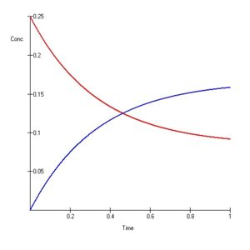
Chemical Equilibrium
A state of dynamic balance in which the rates of forward and reverse reactions are equal
There is no net change in concentrations of reactants or products while a system is in equilibrium

Slide 3
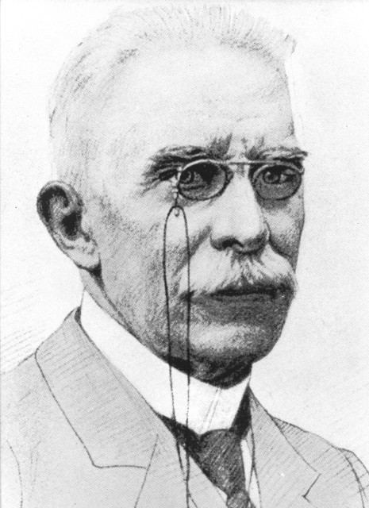
LeChatelier’s Principle
Henri-Louis LeChatelier
Stated that a system at equilibrium, or changing toward equilibrium, responds in the way that tends to relieve or undo any stress placed upon the system…
Systems will not fight back…

Slide 4
LeChatelier’s Principle
Increasing [A]: By LeChatelier’s principle, the reaction shifts to the right to maintain equilibrium.
Increasing [C]: By LeChatelier’s principle, the reaction shifts to the left to maintain equilibrium.
Increasing temperature: By LeChatelier’s principle, the reaction shifts to the right to maintain equilibrium.
ΔH=+VE

Slide 5
Equilibrium Constant (K_{eq})
The equilibrium constant is defined as the product of the equilibrium concentrations (M) of the products, each raised to the power that corresponds to its coefficient in the balanced equation, divided by the product of the equilibrium concentrations of reactants, each raised to the power that corresponds to its coefficient in the balanced equation
aA + bB cC + dD, K_{eq} = [C]^{c}[D]^{d} / [A]ª[B]^{b}

Slide 6
Equilibrium Constant
To describe the equilibrium, we must know the rates of the whole rxn; 2A + B A₂B
Rate_{forward} = k_{for} [A]²[B]
Rate_{reverse} = k_{rev} [A₂B]
At equilibrium, k_{for} [A]²[B] = k_{rev} [A₂B]
Since k_{for} and k_{rev} are constants at given T
k_{rev}/ k_{for} = [A₂B] / [A]²[B] = K_{eq} = equilibrium constant

Slide 7
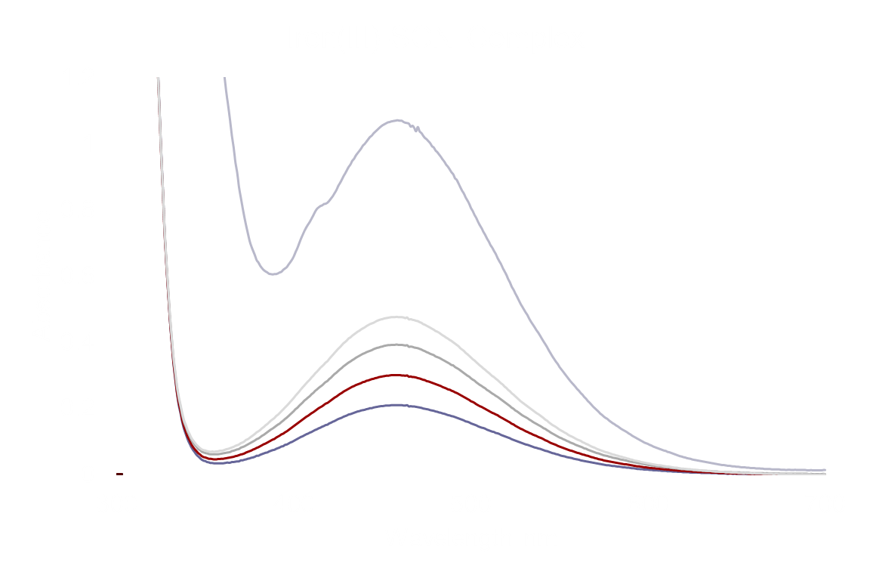

Slide 8
Safety
1.0 M HNO₃ – nitric acid; strong acid, irritant, can cause skin burns; wash any contact areas immediately with water
Wash cuvettes with soap and brush, no acetone!
All waste needs to be poured into the “CHEM 117 Waste” bucket in the back

