Slide 1
Lesson 6: Analysing and interpreting financial statements

Slide 2
Learning outcomes
identify the major categories of ratios that can be used for analysing financial statements;
calculate key ratios for assessing the financial performance and position of a business;
explain the significance of the ratios calculated;
discuss the limitations of ratios as a tool of financial analysis.

Slide 3
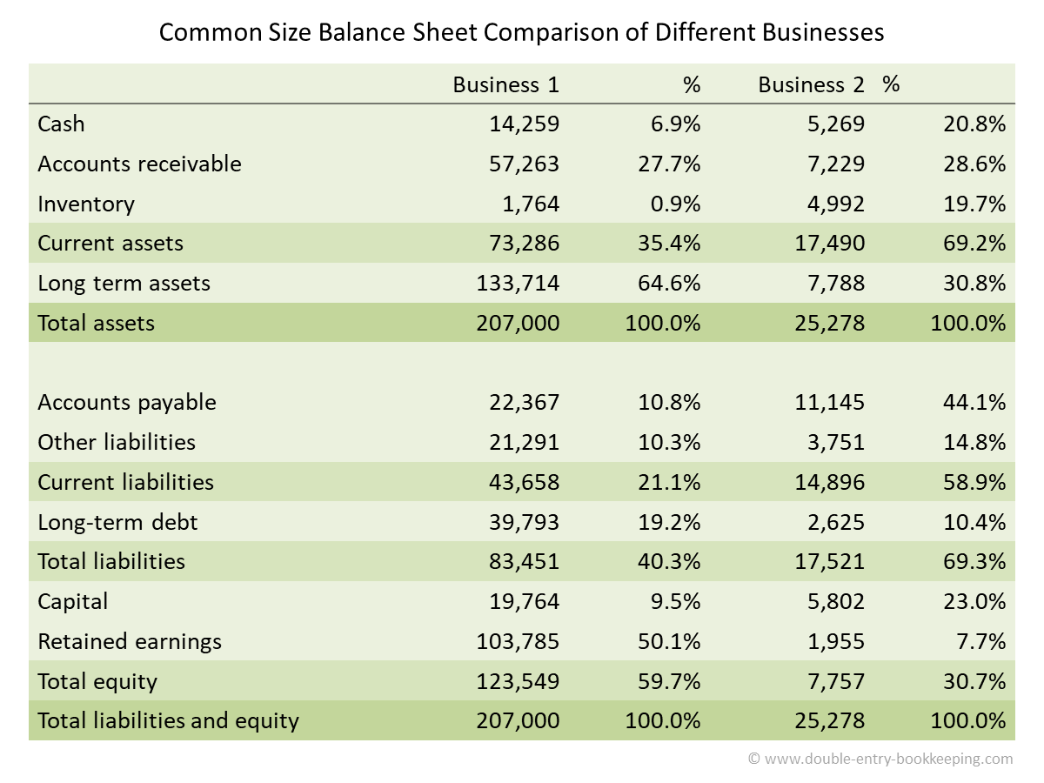
Additional

Slide 4
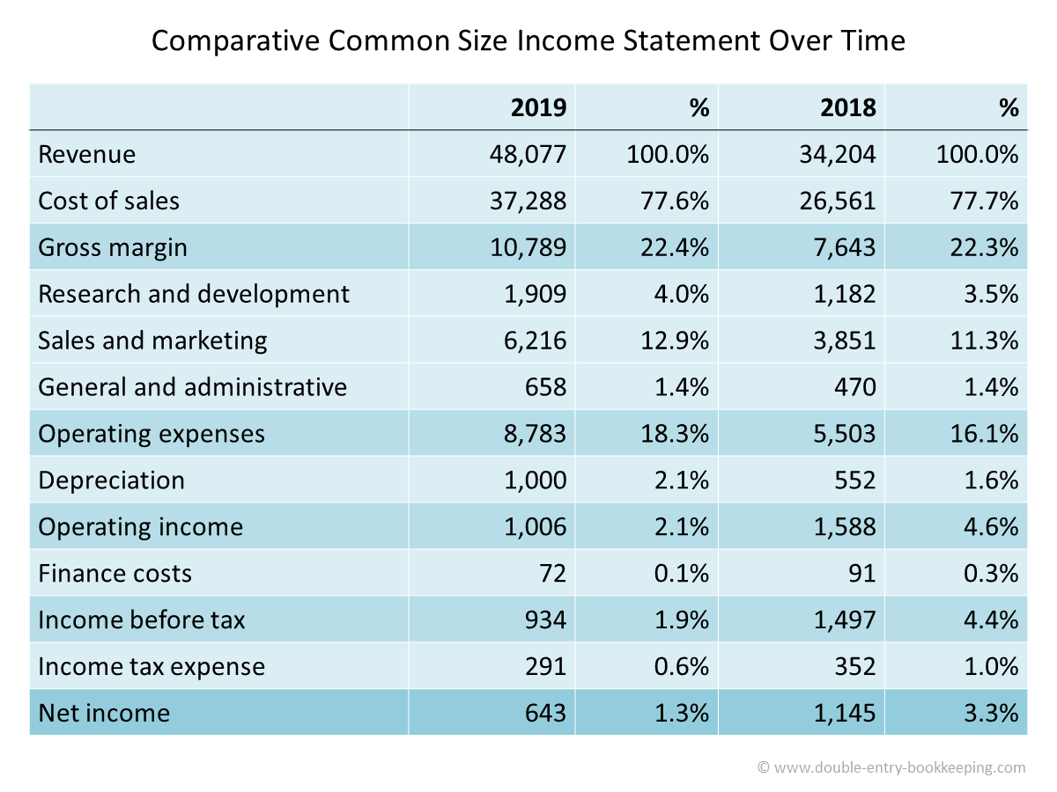
Additional

Slide 5
The key aspects of financial health
Financial ratios
Profitability
Investment
Efficiency
Liquidity
Financial gearing

Slide 6
Ratio benchmark
Ratios may be compared with:
Past periods
Similar businesses for the same period
Planned performance

Slide 7
Profitability ratio
1.return on ordinary shareholders’ funds;
2.return on capital employed;
3.operating profit margin;
4.gross profit margin.

Slide 8
Return on ordinary shareholders’ funds (ROSF)
The return on ordinary shareholders’ funds ratio compares the amount of profit for the period available to owners, with their average investment in the business during that same period.
Return on ordinary shareholders’ funds (ROSF)
Profit for the year (less any preference dividend) × 100 Ordinary share capital + Reserves

Slide 9
Refer to Example 6.1
Calculate ROSF
Year 2015
Year 2016
Notes:
ROSF = 165 (438 + 563)/2 * 100 = 33.0%
ROSF = 11 (563 + 534)/2 * 100 = 2.0%

Slide 10
Return on capital employed (ROCE)
The return on capital employed ratio is a fundamental measure of business performance.
This ratio expresses the relationship between the operating profit generated during a period and the average long-term capital invested in the business.
Return on capital employed (ROCE)
Operating profit × 100 Share capital + Reserves + Non-current liabilities

Slide 11
Refer to Example 6.1
Calculate ROCE
Year 2015
Year 2016
Notes:
ROCE = 243 (638 + 763)/2 * 100 = 34.7%
ROCE = 47 (763 + 834)/2 * 100 = 5.9%

Slide 12
Operating profit margin
The operating profit margin ratio relates the operating profit for the period to the sales revenue.
Operating profit margin
Operating profit × 100 Sales revenue

Slide 13
Refer to Example 6.1
Calculate operating profit margin
Year 2015
Year 2016
Notes:
Operating profit margin = 243 2,240 * 100 = 10.8%
Operating profit margin = 47 2,681 * 100 = 1.8%

Slide 14
Gross Profit Margin
The gross profit margin ratio relates the gross profit of the business to the sales revenue generated for the same period.
Gross profit margin
Gross profit × 100 Sales revenue

Slide 15
Refer to Example 6.1
Calculate gross profit margin
Year 2015
Year 2016
Notes:
Gross profit margin = 495 2,240 * 100 = 22.1%
Gross profit margin = 409 2,681 * 100 = 15.3%

Slide 16
Analysis and interpretation
 | 2015 | 2016
ROSF | 33% | 2%
ROCE | 34.7% | 5.9%
Operating profit margin | 10.8% | 1.8%
Gross profit margin | 22.1% | 15.3%
Notes:
What do you deduce from a comparison of the declines in the operating profit and gross profit margin ratios?
We can see that the difference in the operating profit margin was 9 per cent (that is, 10.8 per cent to 1.8 per cent), whereas that of the gross profit margin was only 6.8 per cent (that is, from 22.1 per cent to 15.3 per cent). This can only mean that operating expenses were greater, compared with sales revenue in 2016, than they had been in 2015. The decline in both ROSF and ROCE was caused partly, therefore, by the business incurring higher inventories’ purchasing costs relative to sales revenue and partly through higher operating expenses compared with sales revenue. We need to compare each of these ratios with their planned levels, however, before we can usefully assess the business’s success.

Slide 17
Take a break and do the exercise
Refer to the Apple Inc,
Calculate …for Year 2016
ROSF
ROCE
Operating profit margin
Gross profit margin
Notes:
pg724

Slide 18
Efficiency ratio
average inventories’ turnover period;
average settlement period for trade receivables;
average settlement period for trade payables;
sales revenue to capital employed;
sales revenue per employee.

Slide 19
Average inventories’ turnover period
Inventories often represent a significant investment for a business.
For some types of business (for example, manufacturers and certain retailers), inventories may account for a substantial proportion of the total assets held
Average inventories held × 365 Cost of sales

Slide 20
Refer to Example 6.1
Calculate average inventories turnover period
Year 2015
Year 2016
Notes:
Average inventories turnover period = (241 + 300)/2 1,745 * 365 = 56.6 days
Average inventories turnover period = (300 + 406)/2 2,272 * 365 = 56.7 days

Slide 21
Average settlement period for trade receivables
The average settlement period for trade receivables ratio calculates how long, on average, credit customers take to pay the amounts that they owe to the business.
Average trade receivables × 365 Credit sales revenue

Slide 22
Refer to Example 6.1
Calculate average settlement period for trade receivables.
Year 2015
Year 2016
Notes:
Average settlement period for trade receivables = (223 + 240)/2 2,240 * 365 = 37.7 days
Average settlement period for trade receivables = (240 + 273)/2 2,681 * 365 = 34.9 days

Slide 23
Average settlement period for trade payables
The average settlement period for trade payables ratio measures how long, on average, the business takes to pay those who have supplied goods and services to it on credit.
Average trade payables × 365 Credit purchases

Slide 24
Refer to Example 6.1
Calculate average settlement period for trade payables.
Year 2015
Year 2016
Notes:
Average settlement period for trade payables = (183 + 261)/2 1,804 * 365 = 44.9 days
Average settlement period for trade payables = (261 + 354)/2 2,378 * 365 = 47.2 days

Slide 25
Sales revenue to capital employed
The sales revenue to capital employed ratio (or net asset turnover ratio) examines how effectively the assets of the business are being used to generate sales revenue.
Sales revenue________________ Share capital + Reserves + Non-current liabilities

Slide 26
Refer to Example 6.1
Calculate sales revenue to capital employed
Year 2015
Year 2016
Notes:
Sales revenue to capital employed = 2,240 (638 + 763)/2 = 3.20 times
Sales revenue to capital employed = 2,681 (763 + 834)/2 = 3.36 times

Slide 27
Sales revenue per employee
The sales revenue per employee ratio relates sales revenue generated during a reporting period to a particular business resource – labour.
Sales revenue Number of employees

Slide 28
Refer to Example 6.1
Calculate sales revenue per employee
Year 2015
Year 2016
Notes:
Sales revenue per employee = £2,240m 13,995 = £160,057
Sales revenue per employee = £2,681m 18,623 = £143,962

Slide 29
Analysis and interpretation
 | 2015 | 2016
Average inventories turnover period | 56.6 days | 56.7 days
Average settlement period for trade receivables | 37.7 days | 34.9 days
Average settlement period for trade payables | 44.9 days | 47.2 days
Sales revenue to capital employed (net asset turnover) | 3.20 times | 3.36 times
Sales revenue per employee | £160,057 | £143,962
Notes:
What do you deduce from a comparison of the efficiency ratios over the two years?
Maintaining the inventories turnover period at the 2015 level may be reasonable, though to assess whether this is a satisfactory period we need to know the planned inventories turnover period. The inventories turnover period for other businesses operating in carpet retailing, particularly those regarded as the market leaders, may have been helpful in formulating the plans. On the face of things, a shorter trade receivables settlement period and a longer trade payables settlement period are both desirable. These may, however, have been achieved at the cost of a loss of the goodwill of customers and suppliers, respectively. The increased sales revenue to capital employed ratio seems beneficial, provided the business can manage this increase. The decline in the sales revenue per employee ratio is undesirable but is probably related to the dramatic increase in the number of employees. As with the inventories turnover period, these other ratios need to be compared with planned, or target, ratios.

Slide 30
Take a break and do the exercise
Refer to the Apple Inc,
Calculate the …
Average inventories turnover period
Average settlement period for trade receivables
Average settlement period for trade payables
Cash conversion cycle*
Notes:
Pg 720

Slide 31
Liquidity ratio
current ratio;
acid test ratio.

Slide 32
Current ratio
The current ratio compares the ‘liquid’ assets (that is, cash and those assets held that will soon be turned into cash) of the business with the current liabilities.
Current assets Current liabilities

Slide 33
Refer to Example 6.1
Calculate current ratio
Year 2015
Year 2016
Notes:
Current ratio = 544 291 = 1.9 times (or 1.9:1)
Current ratio = 679 432 = 1.6 times (or 1.6:1)

Slide 34
Acid test ratio
The acid test ratio is very similar to the current ratio, but it represents a more stringent test of liquidity.
Current assets (excluding inventories) Current liabilities

Slide 35
Refer to Example 6.1
Calculate current ratio
Year 2015
Year 2016
Notes:
Acid test ratio = 544 - 300 291 = 0.8 times (or 0.8:1)
Acid test ratio = 679 - 406 432 = 0.6 times

Slide 36
Analysis and interpretation
 | 2015 | 2016
Current ratio | 1.9 | 1.6
Acid test ratio | 0.8 | 0.6
Notes:
What do you deduce from these liquidity ratios?
There has clearly been a decline in liquidity from 2015 to 2016. This is indicated by both ratios. The decline in the acid test ratio is particularly worrying as it suggests that the business may struggle to meet its short-term obligations. The apparent liquidity problem may, however, be planned, short term and linked to the increase in non-current assets and the number of employees. When the benefits of the expansion come on stream, liquidity may improve. On the other hand, short-term lenders and suppliers may become anxious by the decline in liquidity. This could lead them to press for payment, which is likely to cause further problems.

Slide 37
Take a break and do the exercise
Refer to the Apple Inc,
Calculate the …
Current ratio
Acid test ratio
Notes:
pg720

Slide 38
Financial gearing
Financial gearing occurs when a business is financed, at least in part, by borrowing rather than by owners’ equity.
Let’s look at spread sheet.
Question: What if the operating profit is £100,000?

Slide 39
Financial gearing ratio
gearing ratio;
interest cover ratio

Slide 40
Gearing ratio
The gearing ratio measures the contribution of long-term lenders to the long-term capital structure of a business:
Long-term (non-current) liabilities Share capital + Reserves + Long-term (non-current) liabilities

Slide 41
Refer to Example 6.1
Calculate gearing ratio
Year 2015
Year 2016
Notes:
Gearing ratio = 200 (563 + 200) * 100 = 26.2%
Gearing ratio = 300 (534 + 300) * 100 = 36.0%

Slide 42
Interest coverage ratio
The interest coverage ratio measures the amount of operating profit available to cover interest payable.
Operating profit Interest payable

Slide 43
Refer to Example 6.1
Calculate interest coverage ratio
Year 2015
Year 2016
Notes:
Interest cover ratio = 243 18 = 13.5 times
Interest cover ratio = 47 32 = 1.5 times

Slide 44
Analysis and interpretation
 | 2015 | 2016
Gearing ratio | 26.2% | 36%
Interest coverage ratio | 13.5 times | 1.5 times
Notes:
What do you deduce from a comparison of Alexis plc’s gearing ratios over the two years?
The gearing ratio has changed significantly. This is mainly due to the substantial increase in the contribution of long-term lenders to financing the business. The gearing ratio at 31 March 2016 would not be considered very high for a business that is trading successfully. It is the low profitability that is the problem. The interest cover ratio has fallen dramatically from 13.5 times in 2015 to 1.5 times in 2016. This was partly caused by the increase in borrowings in 2016, but mainly caused by the dramatic fall in profitability in that year. The situation in 2016 looks hazardous. Only a small decline in future operating profits would result in them being unable to cover interest payments. Without knowledge of the planned ratios, it is not possible to reach a valid conclusion on Alexis plc’s gearing.

Slide 45
Take a break and do the exercise
Refer to the Apple Inc,
Calculate
Gearing ratio
Interest coverage ratio
Notes:
pg723

Slide 46
Investment ratio
dividend payout ratio;
dividend yield ratio;
earnings per share;
price/earnings ratio.

Slide 47
Dividend payout ratio
The dividend payout ratio measures the proportion of earnings that is paid out to shareholders in the form of dividends.
Dividends announced for the year Earnings for the year available for dividends
Dividend cover ratio
Earnings for the year available for dividend Dividends announced for the year

Slide 48
Refer to Example 6.1
Calculate dividend payout ratio
Year 2015
Year 2016
Notes:
Dividend payout ratio = 40 165 * 100 = 24.2%
Dividend payout ratio = 40 11 * 100 = 363.6%

Slide 49
Dividend yield ratio
The dividend yield ratio relates the cash return from a share to its current market value.
Dividend per share Market value per share

Slide 50
Refer to Example 6.1
Calculate dividend yield ratio
Year 2015
Year 2016
Notes:
Dividend yield = 0.067* 2.50 * 100 = 2.7%
Dividend yield = 0.067* 1.5 = 100 = 4.5%

Slide 51
EPS and PE ratio
The earnings per share (EPS) ratio relates the earnings generated by the business, and available to shareholders, during a period, to the number of shares in issue.
The price/earnings ratio relates the market value of a share to the earnings per share.
Formula
Earnings per share
Earnings available to ordinary shareholders Number of ordinary shares in issue
Price/earnings ratio (P/E)
Market value per share Earnings per share

Slide 52
Refer to Example 6.1
Calculate EPS and PE ratio
Year 2015
Year 2016
Notes:
EPS = £165m 600m = 27.5p
EPS = £11m 600m = 1.8p
P/E ratio = £2.50 27.5p* = 9.1 times
P/E ratio = £1.50 1.8p = 83.3 times

Slide 53
Analysis and interpretation
 | 2015 | 2016
Dividend payout ratio | 24.2% | 363.6%
Dividend yield ratio | 2.7% | 4.4%
Earnings per share | 27.5p | 1.8p
P/E ratio | 9.1 times | 83.3 times
Notes:
What do you deduce from the investment ratios set out above? Can you offer an explanation why the share price has not fallen as much as it might have done, bearing in mind the much poorer trading performance in 2016?
Although the EPS has fallen dramatically, and the dividend payment for 2016 seems very imprudent, the share price has held up reasonably well (fallen from £2.50 to £1.50). Moreover, the dividend yield and P/E ratios have improved in 2016. This is an anomaly of these two ratios, which stems from using a forward-looking value (the share price) in conjunction with historic data (dividends and earnings). Share prices are based on investors’ assessments of the business’s future. It seems that the ‘market’ was less happy with Alexis plc at the end of 2016 than at the end of 2015. This is evidenced by the fact that the share price had fallen by £1 a share. The decline in share price, however, was less dramatic than the decline in profit for the year. This suggests that investors believe the business will perform better in the future. Perhaps they are confident that the large increase in assets and employee numbers occurring in 2016 will yield benefits in the future; benefits that the business was not able to generate in 2016.

Slide 54
Take a break and do the exercise
Refer to the Apple Inc,
Calculate
Dividend payout ratio
Dividend yield ratio
Earnings per share
P/E ratio
Additional information:
- The market price of Apple’s common stock was $114.42 at September 24, 2016 and $113.85 at September 26, 2015.
Notes:
pg727

Slide 55
Limitations of ratio analysis
Quality of financial statements
Inflation
The restricted view given by ratios
The basis for comparison
Statement of financial position ratios

Slide 56
Seminar 6

