Slide 1
Lesson 4: Accounting for limited companies

Slide 2
Learning outcomes
discuss the nature and financing of a limited company;
describe the main features of the equity in a limited company and the restrictions placed on owners seeking to withdraw part of their equity;
discuss the framework of rules designed to safeguard the interests of shareholders;
explain how the income statement and statement of financial position of a limited company differ in detail from those of sole proprietorships and partnerships.

Slide 3
The main features of limited companies
Legal nature
Perpetual life
Limited liability
Legal safeguards

Slide 4
Public and private companies
The registered company must indicate either as public limited company or private limited company.
A public limited company must signal its status to all interested parties by having the words ‘public limited company’, or its abbreviation ‘plc’, in its name.
For a private limited company, the word ‘limited’ or ‘Ltd’ must appear as part of its name.

Slide 5
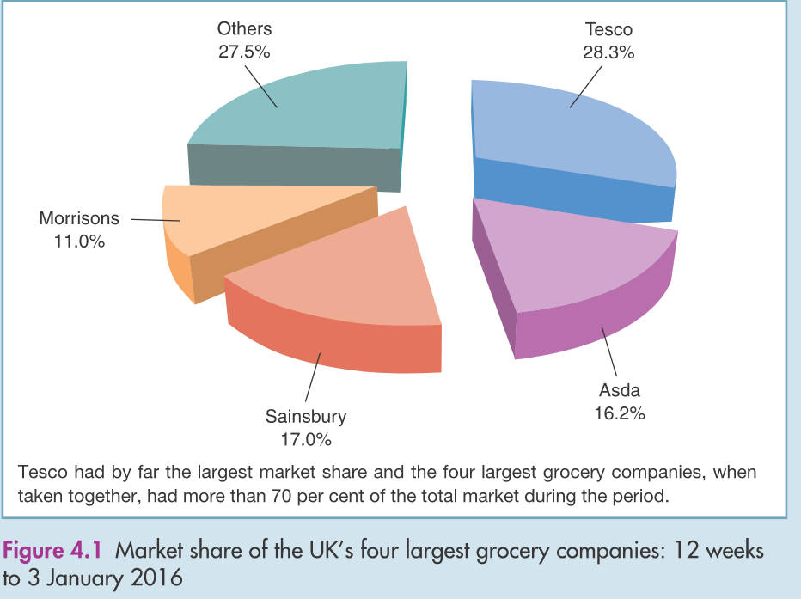

Slide 6
Taxation
Companies must be accountable to the tax authorities for tax on their profits and gains.
Pop quiz: Where can we find the tax charge? Income statement? Balance sheet?
The tax charge for a particular year is based on that year’s profit.
For many companies, only 50 per cent of the tax liability is due for payment during the year concerned; the other 50 per cent will appear on the end-of-year statement of financial position as a current liability.

Slide 7
Taxation
Companies are charged corporation tax on their profits and gains.
Generally, the taxable profit and accounting profit are pretty close but tax law does not follow normal accounting rules.
In UK, the corporate tax rate is 20%.

Slide 8
The role of the stock exchange
Primary market- enable companies to raise new finance
Secondary market- enable investors to sell their securities.
Question: Why do public companies seek to have their shares traded in a recognised Stock Exchange?
Notes:
Investors are generally reluctant to pledge their money unless they can see some way of turning their investment back into cash. The shares of a particular company may be valuable because it has bright prospects. Unless this value can be turned into cash, however, the benefit to investors is uncertain. After all, we cannot spend shares; we normally need cash. Thus, investors are more likely to buy new shares from a company where they can liquidate their investment (turn it into cash) as and when they wish. Stock Exchanges provide the means of liquidation and, by so doing, make it easier for a company to raise new share capital.

Slide 9
Managing a company
Board of directors- manage the company on a day-to-day basis on behalf of shareholders.
At least one director for a private limited company and two for a public limited company.
Directors are not necessary own the shares of the company.

Slide 10
Corporate governance
An important issue in the industry.
Corporate governance is the system by which companies are directed and controlled.
Boards of directors are responsible for the governance of their companies.
The shareholders’ role in governance is to appoint the directors and the auditors and to satisfy themselves that an appropriate governance structure is in place.

Slide 11
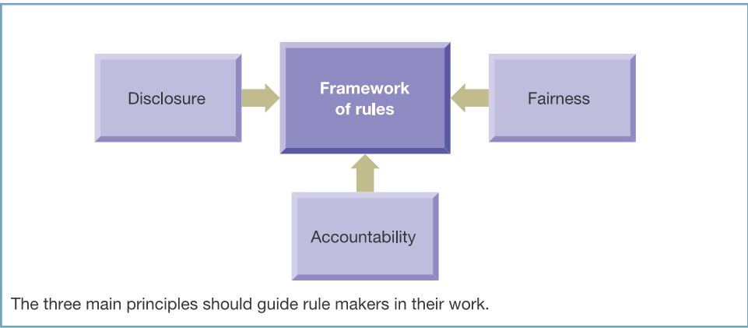
Principles underpinning a framework of rules

Slide 12
The UK Corporate Governance Code:
Refer to reading material- Real world 4.4
The Code has the backing of the London Stock Exchange. This means that companies listed on the London Stock Exchange are expected to comply with the requirements of the Code or must give their shareholders good reason why they do not. Failure to do one or other of these can lead to the company’s shares being suspended from listing.

Slide 13
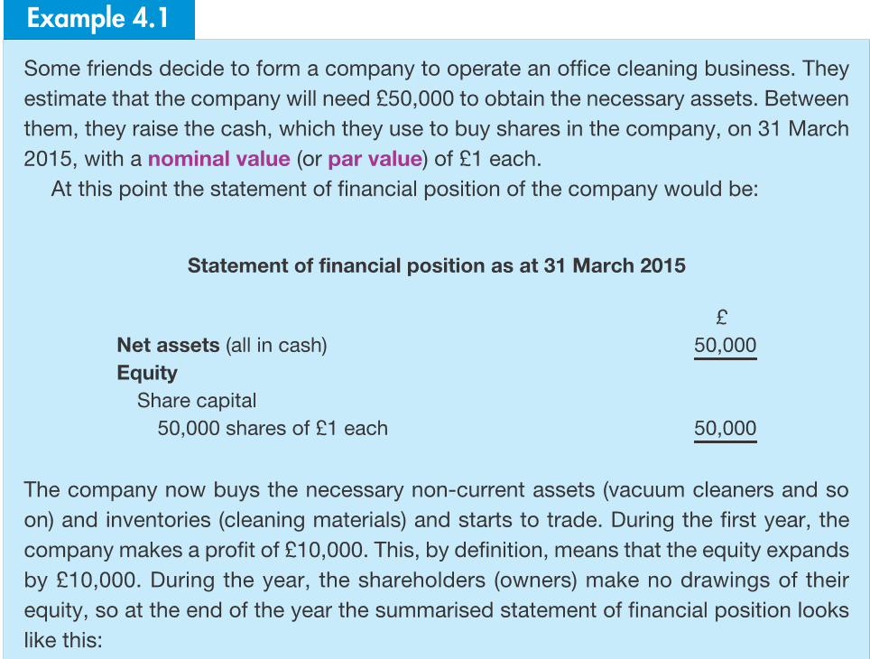
Financing limited companies
Equity

Slide 14
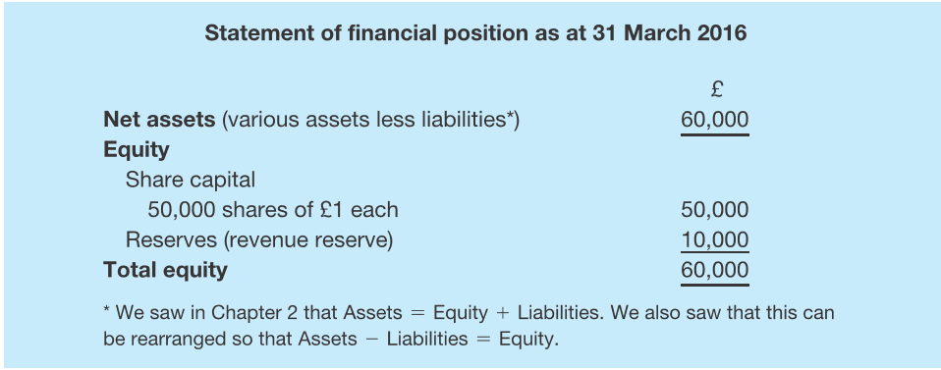
Financing limited companies
Why don’t we combine share capital with revenue reserve?

Slide 15
Answer:
Legal restriction

Slide 16
Equity
Ordinary share
The basic units of ownership of a business.
Primary risk takers
No upper limits on benefit earned
Ability to vote for major issues in the company
All shares must have equal value
Question: The initial financial requirement for a new company is £50,000. There are to be two equal shareholders. Would you advise them to issue two shares of £25,000 each? Why?

Slide 17
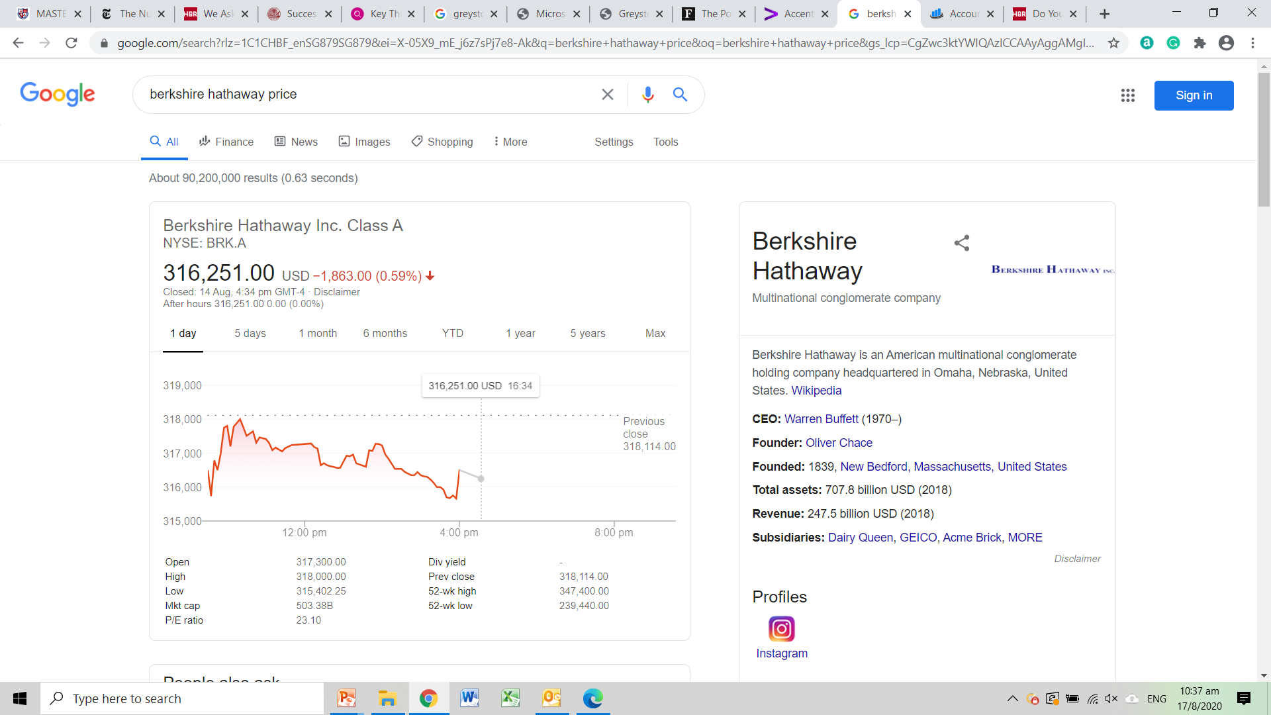
The most expensive stock, would you buy?

Slide 18
Equity
Preference shares
Guarantee that if a dividend is paid.
A fixed percentage of the par value of the preference shares
Example, a million of preference shares of £1 issued with dividend rate of 6%. Total dividend paid is £60,000.
Refer to the memorandum and articles of association to know the different classes of the shares.

Slide 19
Equity
Altering the nominal value of shares
Splitting
Consolidating

Slide 20
Berkshire Hathaway- Class B

Slide 21
Equity
Reserves
Profits and gains
The amount may no longer continue to be part of equity when dividends paid or the company suffered losses.
What is capital reserve?
issuing shares at above their nominal value (for example, issuing £1 shares at £1.50);
revaluing (upwards) non-current assets.

Slide 22
Equity
Usually shares will be issued above the par value. This is why….

Slide 23
Share capital
Share premium

Slide 24
Example of Tesco
Annual report, Page 78

Slide 25
Bonus share
For company to take reserves and converted into share capital.
New shares arising from conversion are known as bonus shares

Slide 26
Reasons for bonus share issue
Share price
Shareholder confidence
Lender confidence

Slide 27
Would you expect a company to pay all of its revenue reserves as a dividend?
22

Slide 28
It would be rare for a company to pay all of its revenue reserves as a dividend: the fact that it is legally possible does not necessarily make it a
good idea. Most companies see ploughed- back profits as a major – usually the major – source of new finance.
23

Slide 29
Borrowings
Long-term basis from pension funds, insurance companies or banks.
Secured on assets of the company

Slide 30
Sources of long-term finance for a typical limited company

Slide 31
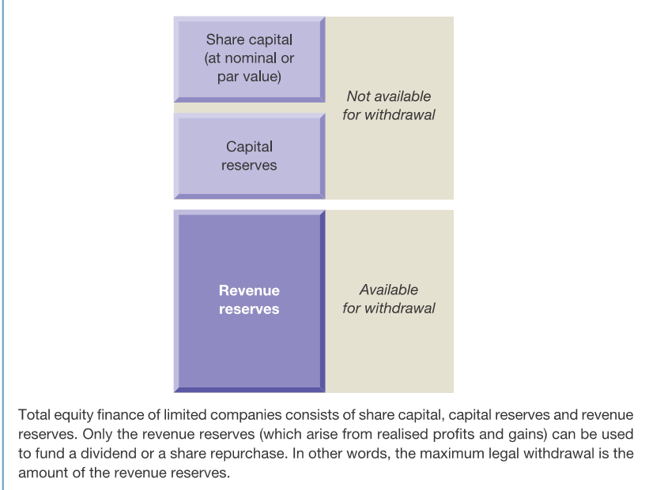
Withdrawing equity

Slide 32
Protection of creditors
Refer reading material- Example 4.4

Slide 33
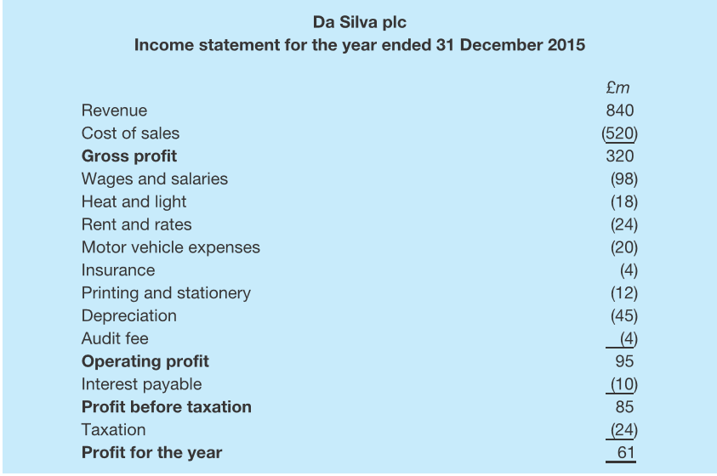
The main financial statements

Slide 34
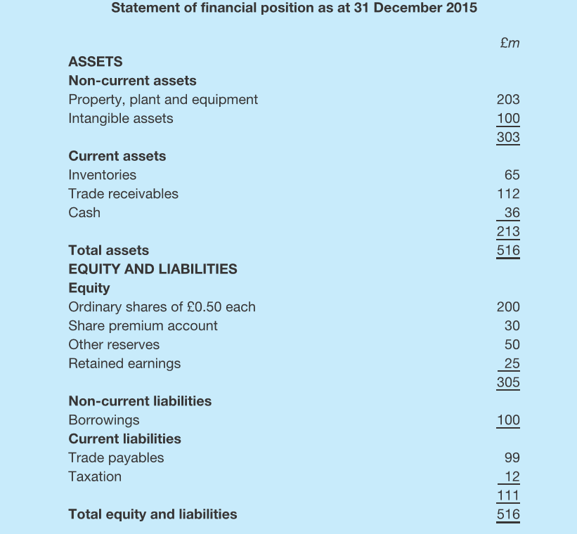
The main financial statements

Slide 35
Statement of comprehensive income
The statement of comprehensive income extends the conventional income statement to include certain other gains and losses that affect shareholders’ equity.
Refer to reading material, Example 4.6, page 145

Slide 36
Statement of changes in equity
help users to understand the changes in share capital and reserves that took place during the period.
Refer to reading material, Example 4.7, page 146

Slide 37
Accounting rules: IFRS
International Financial Reporting Standards
what information should be disclosed;
how information should be presented;
how assets should be valued;
how profit should be measured.

Slide 38
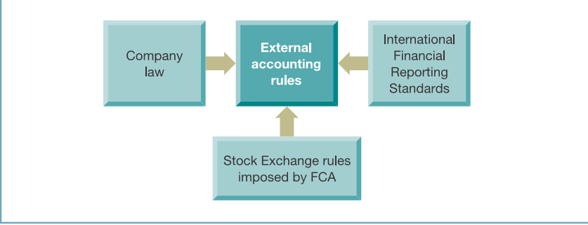
Sources of external accounting rules for a UK public limited company listed on the London Stock Exchange

Slide 39
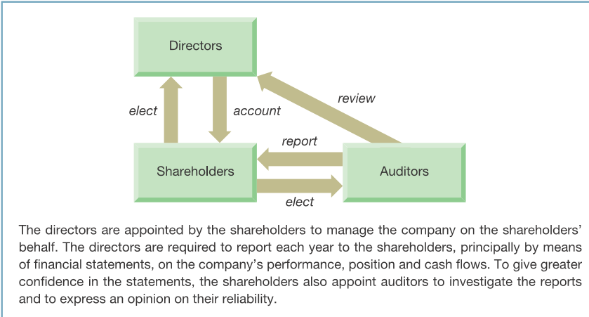
The relationship between the shareholders, the directors and the auditors

Slide 40
Management commentary
Directors’ report
The names of those who were directors
Dividend information
Important events
Future development
Research and development
Strategic report

Slide 41
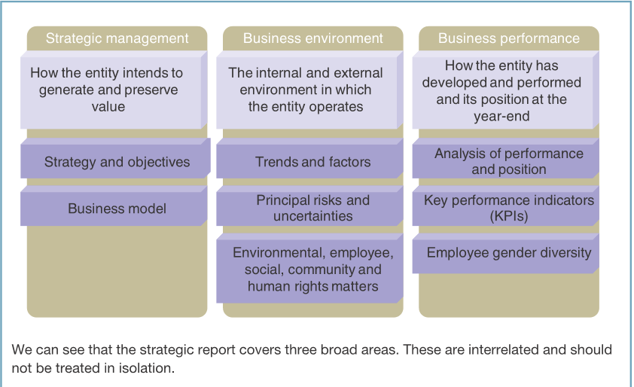
Management commentary

Slide 42
Seminar 4
Refer to the reading material, self-assessment question 4.1

