Slide 1
Lesson 14: Managing working capital

Slide 2
LEARNING OUTCOMES
You should be able to:
Identify the main elements of working capital
Discuss the purpose of working capital and the nature of the working capital cycle
Explain the importance of establishing policies for the control of working capital
Explain the factors that have to be taken into account when managing each element of working capital

Slide 3
Managing Working Capital
Multinational working capital management:
- Working capital management in a multinational enterprise requires managing current assets and current liabilities when faced with political, foreign exchange, tax and liquidity constraints. The overall goal is to reduce funds tied up in working capital while simultaneously providing sufficient funding for the conduct of global business. Working capital management should enhance return on assets and should also improve efficiency ratios and other performance measures.
Working capital management includes:
Trade receivables management
Trade payables management
Inventory management
Cash management

Slide 4
The nature and purpose of working capital
Major elements
Major element
Inventories
Trade payables
Trade receivables
Bank overdrafts
Cash (in hand and at bank)
Working capital
Current assets
Current liabilities
equals
less

Slide 5
Managing Working Capital Management
A firm’s net working capital can be defined as its current assets minus its current liabilities, and the Net Working Capital is the capital required in the short term to run the business.
Working capital includes cash-required to run the business, but not excess cash
(cash-not required to run the business and can be invested at a market rate).
The level of Investments in each of these accounts differs with the type of firms and their business, and the type of industries and industry standards etc.
How firms manage their working capital efficiently and thereby minimize the opportunity costs?
Most projects require the firm to invest in net working capital.
Working capital alters a firm’s value by affecting its free cash flow.
We study the components of net working capital and their effects on the firm’s value.

Slide 6
How does working capital impact a firm’s value?
Any reduction in working capital requirements generates a positive free cash flow that the firm can distribute immediately to shareholders.
E.g. if a firm is able to reduce its required net working capital by
$50,000 permanently, it will be able to distribute this $50,000 as a dividend to its shareholders immediately and thus increase firm value by the same amount.
Similarly, when evaluating a project, reducing the project’s net working capital needs over the project’s life reduces the opportunity cost associated with this use of capital.

Slide 7
Question:
Emerald City Paints would like to construct a new facility that will manufacture paint. In addition to the capital expenditure on the plant, management estimates that the project will require an investment today of $450,000 for net working capital. The firm will recover the investment in net working capital eight years from today, when management anticipates closing the plant. The discount rate for this type of cash flow is 6% per year.
What is the present value of the cost of working capital for the paint facility?
What is the value of an inventory policy that would halve the plant’s net working capital requirements?

Slide 8
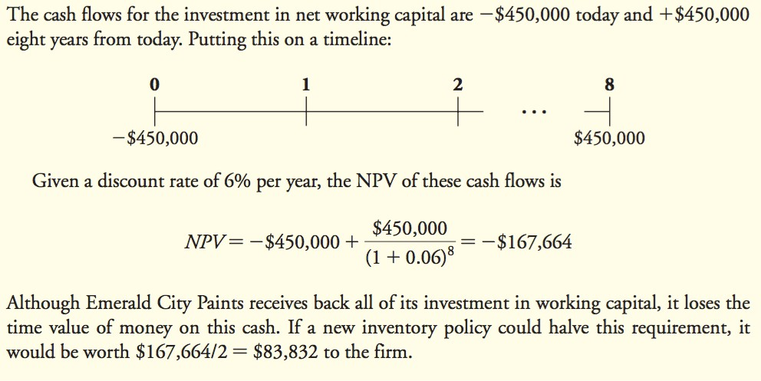
Solution:

Slide 9
The working capital cycle
Cash/ bank overdraft
Cash sales
Finished goods
Trade receivables
Credit sales
Cash
Work in progress
Raw materials
Trade payables

Slide 10
The Cash Cycle
A firm’s cash cycle is the length of time between when the firm pays cash to purchase its initial inventory and when it receives cash from the sale of the output produced from that inventory.
Cash conversion cycle (CCC)
CCC = Accounts Receivable Days + Inventory Days - Accounts Payable Days
where
Accounts Receivable Days = Accounts Receivable Average Daily Sales Inventory Days = Inventory / Average Daily Cost of Goods Sold
Accounts Payable Days = Accounts Payable / Average Daily Cost of Goods Sold

Slide 11
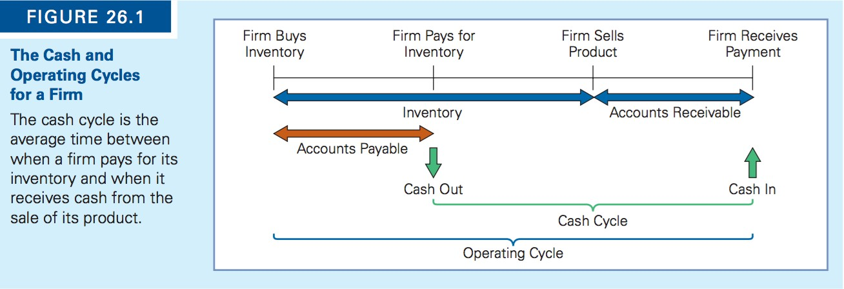
The Cash Cycle

Slide 12
The Operating cycle
The firm’s operating cycle is the average length of time between when a firm originally purchases its inventory and when it receives the cash back from selling its product.
If the firm pays cash for its inventory, this period is identical to the firm’s cash cycle.
However, most firms buy their inventory on credit, which reduces the amount of time between the cash investment and the receipt of cash from that investment.
The longer a firm’s cash cycle, the more working capital it has, and the more cash it needs to carry to conduct its daily operations.
Because of the characteristics of different industries, working capital levels vary significantly.

Slide 13
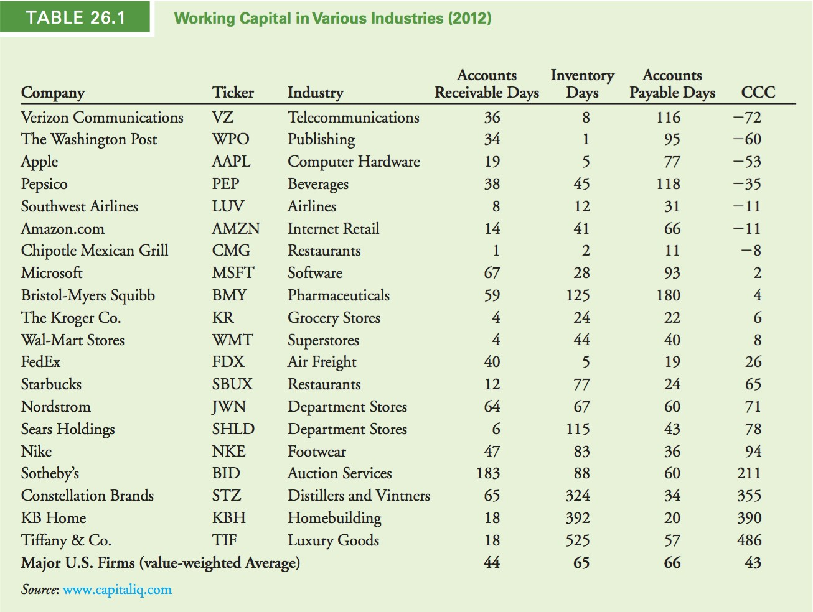

Slide 14
Cash Management
Motivation for Holding Cash
To meet its day-to-day needs
To compensate for the uncertainty associated with its cash flows
To satisfy bank requirements
Alternative Investments
The firm will invest any cash in short-term securities. In fact, the firm may choose from a variety of short-term securities that differ somewhat with regard to their default risk and liquidity risk.
The greater the risk, the higher the expected return on the investment.
The financial manager must decide how much risk she is willing to accept in return for a higher yield.
If her firm expects to need the funds within the next 30 days, the manager will probably avoid the less liquid options.

Slide 15
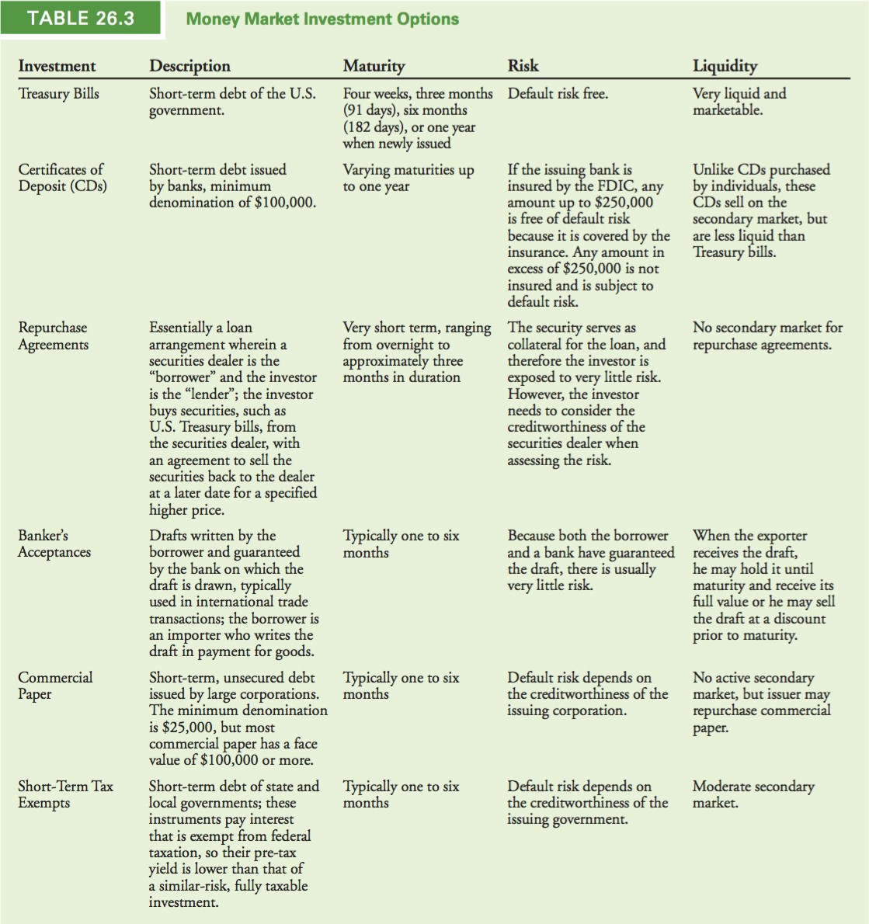

Slide 16
Trade Credit
Accounts receivable: represents the credit sales for which a firm has yet to receive payment.
Accounts payable: represents the amount that a firm owes its suppliers for goods that it has received but for which it has not yet paid.
Trade Credit: the credit that the firm is extending to its customer.
A firm would, of course, prefer to be paid in cash at the time of purchase, but a “cash-only” policy may cause it to lose its customers to competition.
How managers can compare the costs and benefits of trade credit to determine optimal credit policies?

Slide 17
Trade Credit
“Net 30”: payment is not due until 30 days from the date of the invoice. (“30” is not a magic number; the invoice could specify “Net 40,” “Net 15,” or any other number of days as the payment due date.)
“2/10, Net 30” mean that the buying firm will receive a 2% discount if it pays for the goods within 10 days; otherwise, the full amount is due in 30 days.
In a perfectly competitive market, trade credit is just another form of financing.
Under the Modigliani-Miller assumptions of perfect capital markets, the amounts of payables and receivables are therefore irrelevant.
In reality, product markets are rarely perfectly competitive, so firms can maximize their value by using their trade credit options effectively.

Slide 18
Trade Credit
Cost of Trade Credit:
Trade credit is a loan from the selling firm to its customer.
The price discount represents an interest rate.
Firms offer favorable interest rates on trade credit as a price discount to their customers.
Financial managers should evaluate the terms of trade credit to decide whether to use it.
Question:
Your firm purchases goods from its supplier on terms of 1/15, Net 40. What is the effective annual cost to your firm if it chooses not to take advantage of the trade discount offered?

Slide 19
Trade Credit
Answers:
Because the discount is 1%, for a $100 purchase your firm must pay either $99 in 15 days or $100 in 40 days.
The interest rate for the 25 day term of the loan is $1/ $99=1.01%
Given the difference of 25 days (40 - 15), these terms correspond to an effective annual rate (With a 365 day year) of
Thus, by not taking the discount, the firm is effectively paying 1.01% to borrow the money for 25 days, which translates to an effective annual rate of 15.8%!
If the firm can obtain a bank loan at a lower interest rate, it would be better off borrowing at the lower rate and using the cash proceeds of the loan to take advantage of the discount offered by the supplier.

Slide 20
Trade Credit
Benefits of Trade Credit as an attractive source of funds:
Simple and convenient to use and has lower transaction costs.
(e.g. no paperwork must be completed, as would be the case for a loan from a bank.)
Flexible source of funds and can be used as needed.
Sometimes, it is the only source of funding available to a firm.

Slide 21
Trade Credit
Trade Credit Versus Standard Loans
Providing financing at below-market rates is an indirect way to lower prices for only certain customers.
A supplier may have an ongoing business relationship with its customer, it may have more information about the credit quality of the customer than a traditional outside lender such as a bank. The supplier may also be able to increase the likelihood of payment by threatening to cut off future supplies if payment is not made.
If the buyer defaults, the supplier may be able to seize the inventory as collateral. This inventory is likely to be more valuable to a company within the industry.

Slide 22
Managing Float
The delay between the time a bill is paid and the cash is actually received (or processing float), will impact a firm’s working capital requirements.
Collection float: is the amount of time it takes for a firm to be able to use funds after a customer has paid for its goods.
Firms can reduce their working capital needs by reducing their collection float.
Collection float is determined by three factors:
Mail float: How long it takes the firm to receive the check after the customer has mailed it
Processing float: How long it takes the firm to process the check and deposit it in the bank
Availability float: How long it takes before the bank gives the firm credit for the funds

Slide 23
Managing Float
Disbursement float: the amount of time it takes before payments to suppliers actually result in a cash outflow for the firm. Like collection float, it is a function of mail time, processing time, and check-clearing time. Although a firm may try to extend its disbursement float in order to lengthen its payables and reduce its working capital needs, it risks making late payments to suppliers. In such a case, the firm may be charged an additional fee for paying late or may be required to pay cash before delivery (CBD) or on delivery (COD) for future purchases. In some cases, the supplier may refuse to do business in the future with the delinquent firm.
Firms can employ several methods to reduce their collection and disbursement floats.
Methods to reduce disbursement float:
Check 21: The Check Clearing for the 21st Century Act became effective on October 28, 2004, eliminated the disbursement float due to the check-clearing process.
Methods to reduce collection float:
E.g. the firm may streamline its in-house check-processing procedures. In addition, with electronic collection, funds are automatically transferred from the customer’s bank account to the firm’s bank account on the payment date, reducing the collection float to zero.

Slide 24
Accounts Receivable Management
Accounts Receivable Management: How a firm adopts a policy for offering credit to its customers and how it monitors its accounts receivable on an ongoing basis?
Determining the Credit Policy
Establishing a credit policy involves three steps:
Establishing credit standards
Establishing credit terms
Establishing a collection policy

Slide 25
Accounts Receivable Management
Monitoring Accounts Receivable
Accounts Receivable Days
the average number of days that it takes a firm to collect on its sales.
A firm can compare this number to the payment policy specified in its credit terms to judge the effectiveness of its credit policy.
If the credit terms specify “Net 30” and the accounts receivable days outstanding is 50 days, the firm can conclude that its customers are paying 20 days late, on average.
Compare the accounts receivable days in different years.
Aging Schedule
categorizes accounts by the number of days they have been on the firm’s books.
It can be prepared using either the number of accounts or the dollar amount of the accounts receivable outstanding.

Slide 26
Accounts Receivable Management
Aging Schedule Example:
If the firm’s average daily sales is $65,000, its accounts receivable days is $1,600,000/$65,000 = 25 days. But on closer examination, using the aging schedules in Table 26.2, we can see that 28% of the firm’s credit customers (and 39% by dollar amounts) are paying late.

Slide 27
Accounts Receivable Management
Question:
Financial Training Systems (FTS) bills its accounts on terms of 3/10, Net 30.
The firm’s accounts receivable include $100,000 that has been outstanding for 10 or fewer days, $300,000 outstanding for 11 to 30 days, $100,000 outstanding for 31 to 40 days, $20,000 outstanding for 41 to 50 days, $10,000 outstanding for 51 to 60 days, and $2000 outstanding for more than 60 days. Prepare an aging schedule for FTS.

Slide 28
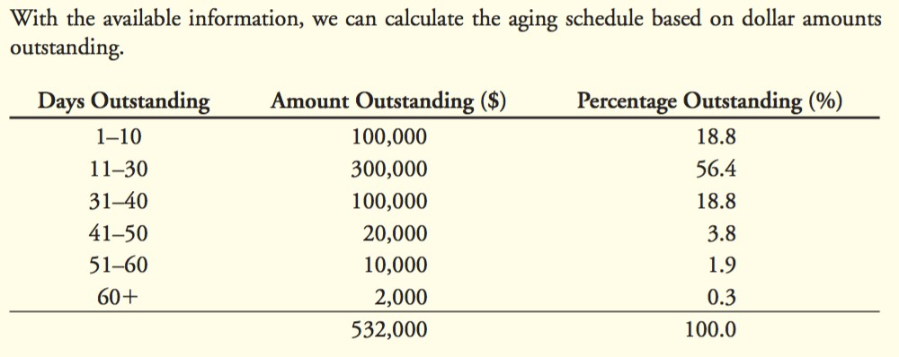
Accounts Receivable Management
Answers:

Slide 29
Accounts Payables Management
A firm should choose to borrow using accounts payable only if trade credit is the cheapest source of funding.
The cost of the trade credit depends on the credit terms.
The higher the discount percentage offered, the greater the cost of forgoing the discount.
The cost of forgoing the discount is also higher with a shorter loan period.
When a company has a choice between trade credit from two different suppliers, it should take the less expensive alternative.
A firm should always pay on the latest day allowed.
(e.g. if the discount period is 10 days and the firm is taking the discount, payment should be made on day 10, not on day 2. If the discount is not taken and the terms are 2/10, Net 30, the full payment should be made on day 30, not on day 16.)

Slide 30
Accounts Payables Management
Determining Accounts Payable Days Outstanding
One method is to calculate the accounts payable days outstanding and compare it to the credit terms.
Question:
The Rowd Company has an average accounts payable balance of $250,000. Its average daily cost of goods sold is $14,000, and it receives terms of 2/15, Net 40, from its suppliers. Rowd chooses to forgo the discount. Is the firm managing its accounts payable well?
Answers:
The firm is not managing its accounts payable well. Rowd’s accounts payable days outstanding is
$250,000/$14,000 = 17.9 days. If Rowd made payment three days earlier, it could take advantage of the 2% discount. If for some reason it chooses to forgo the discount, it should not be paying the full amount until the fortieth day.

Slide 31
Accounts Payables Management
Stretching Accounts Payable
Some firms ignore the payment due period and pay later, in a practice referred to as stretching the accounts payable.
Question:
What is the effective annual cost of credit terms of 1/15, Net 40, if the firm stretches the accounts payable to 60 days?
Answer:
The interest rate per period is $1/$99 = 1.01%. If the firm delays payment until the 60th day, it has use of the funds for 45 days beyond the discount period. There are 365/45 = 8.11 45-day periods in one year.
Thus, the effective annual cost is

Slide 32
Inventory Management
Benefits of Holding Inventory
Inventory helps minimize the risk that the firm will not be able to obtain an input it needs for production.
If a firm holds too little inventory, stock-outs, the situation when a firm runs out of goods, may occur, leading to lost sales.
Firms may hold inventory because factors such as seasonality in demand mean that customer purchases do not perfectly match the most efficient production cycle. E.g. Toy company.
Costs of Holding Inventory
We can classify the direct costs associated with inventory into three categories:
Acquisition costs are the costs of the inventory itself over the period being analyzed (usually one year).
Order costs are the total costs of placing an order over the period being analyzed.
Carrying costs include storage costs, insurance, taxes, spoilage, obsolescence, and the opportunity cost of the funds tied up in the inventory.

Slide 33
Inventory Management
Procedures and techniques that can be used to ensure the proper
management of inventories
Budgeting future demand
Financial ratios
Recording and reordering systems
Levels of control
Inventories’ management models
Just-in-time inventories management

Slide 34
Financial ratios
Average inventories turnover period
=
Average inventories held × 365 Cost of sales

Slide 35
Levels of Control
- ABC method of analysing and controlling inventories
100
Cumulative value of inventories items
(%)
0 A
B C 100
Volume of inventories items held (%)

Slide 36
Inventories’ Management Models
- Economic Order Quantity (EOQ) ‘Patterns of inventories movements over time’
Inventories level
0
Time

Slide 37
Inventories holding and order costs
Annual costs (£)
Ordering costs
Total costs
Holding costs
0
E
Average inventories level (units)

Slide 38
The economic order quantity (EOQ) model
EOQ
=
2DC H
Where:
D = the annual demand for the inventories item (expressed in units of the inventories items);
C = the cost of placing an order;
H = the cost of holding one unit of the inventories item for one year.

Slide 39
Just-in-time inventories management
Requires close relationship with suppliers
May require re-engineering production process
May result in hidden costs (taking advantage of cheap sources of supply)
Can be seen as part of TQM approach

