Slide 1
Lesson 3: Measuring and Reporting Financial Performance

Slide 2
Learning outcomes
Discuss the nature and purpose of the income statement
Prepare an income statement from relevant financial information and interpret the information that it contains

Slide 3
The income statement
Income Statement is to measure and report how much profit (wealth) the business has generated over a period of time.
Measuring and reporting financial performance in terms of revenues, expenses, and profits/losses over a given time period.

Slide 4
Income statement terminology
Revenue - Money derived from selling the company’s product or service, the inflow of economic benefits arising from the ordinary activities of a business.
Examples
Sales of goods by a manufacturer
Fees for services of a solicitor
Subscriptions of a club
Interest received from an investment

Slide 5
Income statement terminology
Expense - The cost of producing or acquiring the goods or services to be sold, the outflow of economic benefits arising from the ordinary activities of a business.
Examples:
Cost of goods sold or cost of sales
Salaries and wages
Rent and rates
Motor vehicle running expenses Insurance
Printing and stationery
Heat and light
Telephone and postage

Slide 6
Income statement: Equation
Profit (or loss) for the period =
Total revenue for the period
–
Total expenses incurred in generating that revenue

Slide 7
Review: Relationship between balance sheet and income statement
Assets (at the end of the period) =
Equity (amount at the start of the period)
+ Profit (or –loss) for the period
+ Liabilities (at the end of the period)
(Assuming that owner makes no injections or withdrawals of equity during the period.)

Slide 8
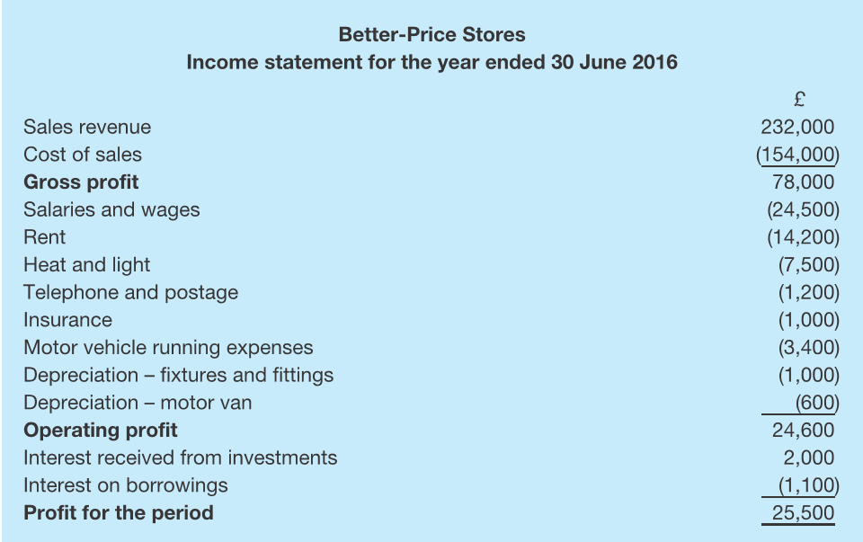
Income statement layout

Slide 9
Income statement layout
Sales revenue
Less cost of goods sold (cost of sales)
(Opening stocks + Purchases) - Closing Stocks (COGS)
= Gross profit
Less operating expenses
(salaries and wages, heat and light, insurance, motor vehicle running expenses, depreciation etc.)
= Operating profit
Less non-operating expenses
(e.g. Less interest expense or Plus interest income)
Profit for the period (or Earnings before taxes)
Less corporate taxes
= Profit/Earnings before preferred dividends
Less preferred stock dividends
= Net profit/income available to shareholders
Notes:
e.g. interest on borrowings)
e.g. interest received from investments)

Slide 10
Income statement correction
Error on income statement
Staff performance bonuses amounting to £12,500 had been charged to cost of sales.
The depreciation charge for fixtures and fittings should be £10,000 not £1,000.
Stationery costing £500 had been treated as interest on borrowings.

Slide 11
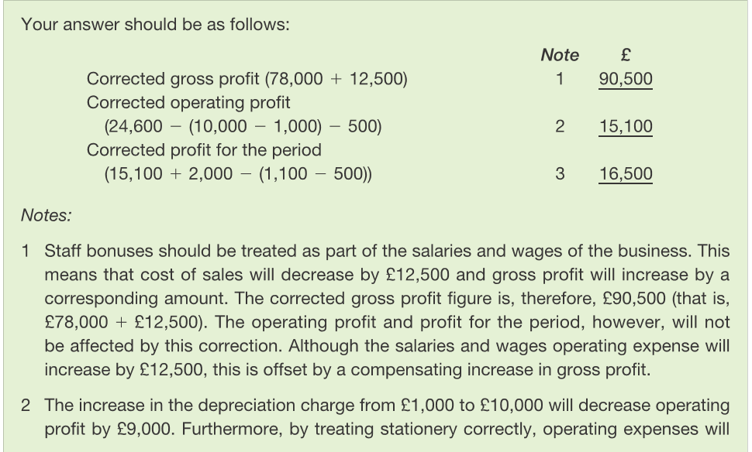
Answer

Slide 12
Cost of Sales
Direct costs attributable to the production of goods or supply of services by an entity.
Not all companies will have cost of sales because they don’t carry inventory.
Real estate firms
Accounting firms

Slide 13
Cost of sales (Example)
Better-Price Stores, which we considered in Example 3.1 above, began the year with unsold inventories of £40,000 and during that year bought inventories at a cost of £189,000. At the end of the year, unsold inventories of £75,000 were still held by the business.

Slide 14
Income statement (partial)

Slide 15
Gross profit
The Income Statement starts with sales (revenues).
Sales (Revenue)
minus
Cost of goods sold/ cost of sales
equals
Gross profit
Quantity sold X price per unit

Slide 16
Operating profit
Operating profit is the total profit firm makes from running the business before paying creditors (interest expense) for the use of debt, and paying income taxes to the government.
Operating profit is the best profit indicator of how well a company is doing in its business.

Slide 17
Operating profit
Compute operating profit (earnings before interest & taxes)
Sales (Revenue)
minus
Cost of goods sold/ cost of sales
equals
Gross profit
minus
Operating expenses
equals
Operating profit

Slide 18
Operating expenses
In addition to the cost of goods sold, you need to convince someone to buy what you are selling. So, you will have:
Marketing expenses
And you have operating overhead — e.g. the light bill must be paid. So, you will have:
General & administrative expenses
And if you have equipment and buildings, you will have depreciation expense (more on this later).

Slide 19
Operating expenses & finance costs
Operating Expenses - Expenses related to marketing and distributing the product or service and administering the business.
Financing Costs - The interest paid to creditors and
the dividends paid to preferred stockholders.
Returns to Owners -
Examples:
Income /corporation taxes to the government
Interest on loan finance (to service loan)
Deduct Preference shareholders (dividends)
Profit for shareholders - the residual return.

Slide 20
Interest expense - The cost of borrowing money
A lender charges interest to loan money, which is shown as interest expense in the income statement of the borrower.
Interest expense is the result of the interest rate and the amount borrowed.
Interest Rate X Amount borrowed = Interest expense

Slide 21
Profit before taxes
Operating profit
minus
Interest expenses
equals
Profit before taxes

Slide 22
Example:
If a firm has £15,000 in operating income and £50,000 in debt at a 6% interest rate.
What is the profit before taxes?
15,000 – 50,000*6%=12000
Notes:
Operating Income
£ 15,000
Interest Expense
£ (3,000)
Profit before taxes
£ 12,000

Slide 23
Net Profit/ Income
Operating profit
minus
Interest expenses
equals
Profit before taxes
minus
Income taxes
equals
Net income

Slide 24
Compute:
If a firm has operating income of £15,000 and earning before taxes of £12,000. The corporate income tax is 25%.
What is the net income?
12000-（12000*25%）=9000

Slide 25
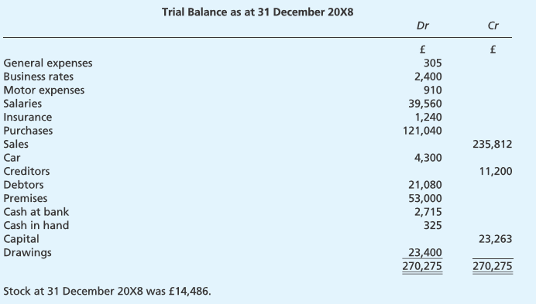
Relax and chill: Exercise Time
Prepare an income statement for the year ended 31 December 20X8. (Hint: Not all items listed should appear on the income statement. Ignore debit and credit)

Slide 26
Depreciation
Most non-current assets do not have a perpetual existence. They are eventually used up in the process of generating revenue for the business.
Depreciation is the allowance for wear and tear on some fixed assets like, plant and machinery.
Depreciation is an attempt to measure that portion of the cost of a non-current asset that has been used up in generating the revenue recognized during a particular period.
The depreciation charge is considered to be an expense of the period to which it relates.
Amount of decreasing value in a capital asset allowed to be deducted from a business tax return.
Depreciation allows “cost recovery” on capital asset purchases in the business.
Depreciation is NOT a real cash flow and you can NEVER depreciate land.

Slide 27
Depreciation
Accumulated depreciation: Shows amount that the asset has lost in value since its purchase.
Depreciation expense: Shows the amount that the asset has lost in value this period.
Causes of decline in fixed assets:
Physical depreciation: Occurs from the wear and tear.
Functional depreciation: Occurs when a fixed asset is no longer able to provide services at the level for which it was intended.

Slide 28
Depreciation
Depreciation is the measure of the:
Wearing out
Consumption
Other reductions in the useful economic life of a fixed asset
Arising from:
use
passage of time
obsolescence

Slide 29
Depreciation terminology
The cost (or fair value) of the asset
The useful life of the asset
Residual value (disposal value)
Depreciation method

Slide 30
Depreciation methods
Straight Line Method (SLM): Depreciated equally over the useful life of the asset.
Reducing Balance Method (RBM): A fixed percentage rate of depreciation to the carrying amount of the asset each year.
carrying amount = net book value
net book value = Cost of Fix Asset – Accumulated depreciation

Slide 31
1. Depreciation method – straight line
Straight line depreciation is calculated as the cost of the asset, minus the estimated disposal value, divided by the number of expected years of use.直线折旧计算为 : 资产成本 - 估计处置价值，除以 预期使用年限

Slide 32
Compute:
Question: The lorry was bought for £22,000 and keep it for four years would have no disposal value, what is the charge for depreciation?

Slide 33
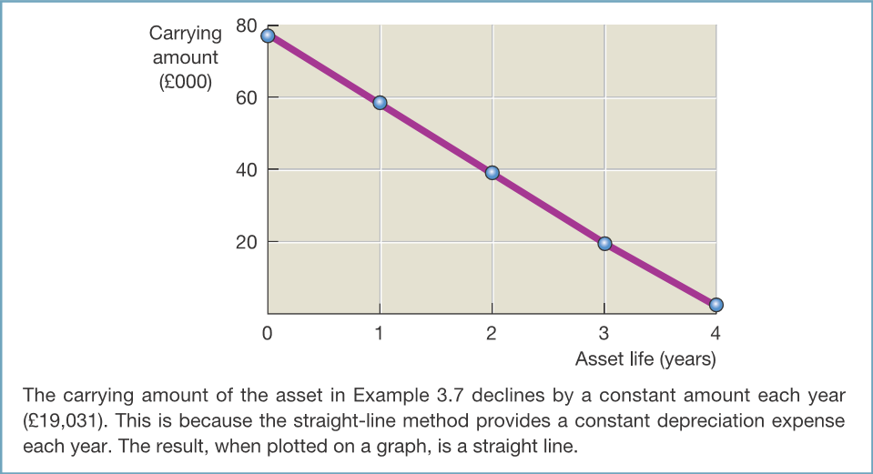
1. Depreciation method – straight line

Slide 34
2. Depreciation methods – reducing balance
A fixed percentage for depreciation is deducted from the cost in the first year.
In the second or later years the same percentage is taken of the reduced balance(net book value).
Also known as diminishing balance method(reducing balance).
For example, if a machine is bought for £10,000 and depreciation is to be charged at 20 per cent, calculate the depreciation for first year, second year and third year.

Slide 35
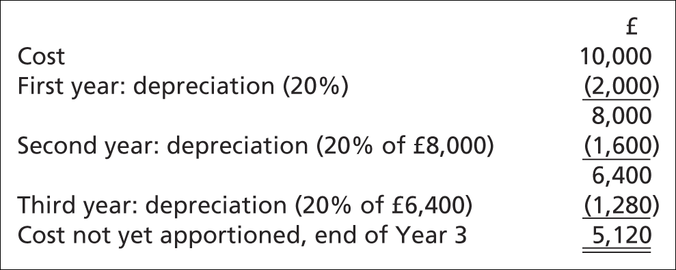
2. Depreciation methods – reducing balance
Reducing balance depreciation is calculated using a fixed percentage, on the net value of the asset.

Slide 36
2. Depreciation methods – reducing balance
What if you would like to find the percentage that apply to this method?
$r=1−\sqrt[n]{\frac{s}{c}}$
where
n = the number of years
s = the net residual value
c = the cost of the asset
r = the rate of depreciation to be applied.

Slide 37
2. Depreciation methods – reducing balance
Example, If a machine is bought for £10,000, the residual value is £256 and keep for 4 years. Calculate the rate of depreciation that applied.
$r=1−\sqrt[4]{\frac{256}{10,000}}$
r= 60%
$$r=1−\sqrt[n]{\frac{s}{c}}$$

Slide 38
2. Depreciation methods – reducing balance

Slide 39
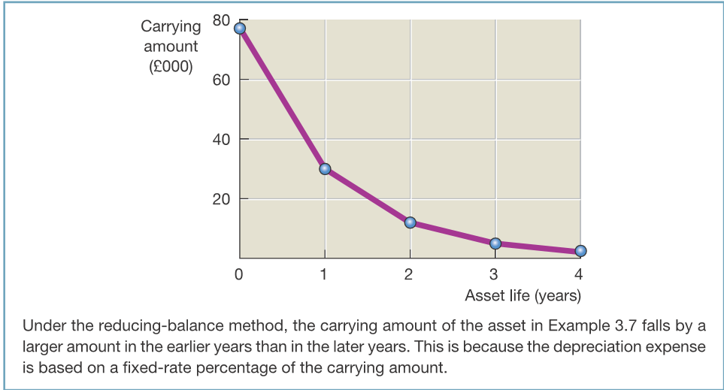
2. Depreciation methods – reducing balance

Slide 40
Choice of method
The method chosen should be the one that allocates the cost to each period in accordance with the overall economic benefit from the use of the asset.
Therefore, if more benefit is derived from the asset in early years, then the reducing balance method is more appropriate.
However, if benefits are spread equally over the years, the straight line method is suitable.

Slide 41
Choice of method: comparison
A business has just bought a machine for £8,000. It will be kept in use for four years, when it will be disposed of for an estimated amount of £500. The accountant has asked you to prepare a comparison of the amounts charged as depreciation using both methods.

Slide 42
Relax and chill: Exercise time
Gillian purchased a notebook PC for £2,600. It has an estimated life of four years and a scrap value of £200. She is not certain whether she should use the straight line or the reducing balance basis for the purpose of calculating depreciation on the computer.
You are required to calculate the depreciation (to the nearest £) using both methods. (Assume that 45 percent per annum is to be used for the reducing balance method.

Slide 43
Exercise 1
Gillian purchased a notebook PC for £2,600. It has an estimated life of four years and a scrap value/ disposal value/ residual value of £200. She is not certain whether she should use the straight line or the reducing balance basis for the purpose of calculating depreciation on the computer.
Year | Cost | Depreciation charge | Net Book Value
1 | £2,600 | £600 | £2000
2 | £2000 | £600 | £1400
3 | £1400 | £600 | £800
4 | £800 | £600 | £200

Slide 44
Exercise 1
Aggregate/ Total depreciation→ a contra asset under non-fixed assets in the balance sheet
Cumulative depreciation of an asset up to a single point in its life.
Year | Cost | Depreciation charge (Profit and Loss Statement/ Account) | Aggregate /Accumulated Depreciation | Net Book Value
1 | £2,600 | £600 | £600 | £2000
2 | £2000 | £600 | £1200 | £1400
3 | £1400 | £600 | £1800 | £800
4 | £800 | £600 | £2400 | £200

Slide 45
Exercise 1- RBM (45%)
Aggregate/ Total depreciation→ a contra asset under non-fixed assets in the balance sheet
Cumulative depreciation of an asset up to a single point in its life.
Year | Cost | Depreciation charge (Profit and Loss Statement/ Account) | Aggregate /Accumulated Depreciation | Net Book Value
1 | £2,600 | £1170 | £1170 | £1430
2 | £1430 | £643.50 | £1813.50 | £786.50
3 | £786.50 | £353.93 | £2167.43 | £432.57
4 | £432.57 | £194.66 | £2362.09 | £237.91

Slide 46
Other management issues:
There are other management and financial reports you may find useful for managing your business that provide more detail for income statement and balance sheet accounts, e.g:
Sales revenue (e.g. Cash)
Unpaid invoices
Accounts receivables (Debtors)-bad debt
Accounts payables (Creditors)
Costing Inventories (FIFO, LIFO, AVCO)

Slide 47
Pop quiz:
If depreciation reduces profits and reduces the value of assets and so reduces the capital account of the owner, why do businesses bother providing for depreciation?

Slide 48
Answer:
financial statements must show a true and fair view of the financial performance and position of the business.
If depreciation was not provided for, both fixed assets and profits would be stated in the financial statements at inflated amounts.
This would only mislead the users of those financial statements and, so, depreciation must be charged.

Slide 49
Seminar question- download from Canvas
Critical thinking question 2.

Slide 50
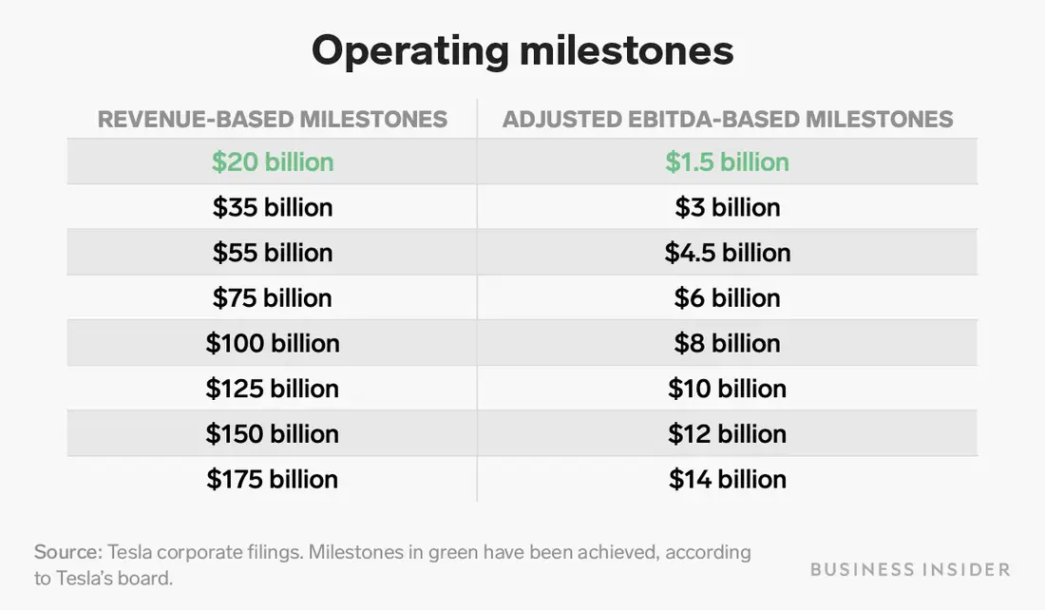
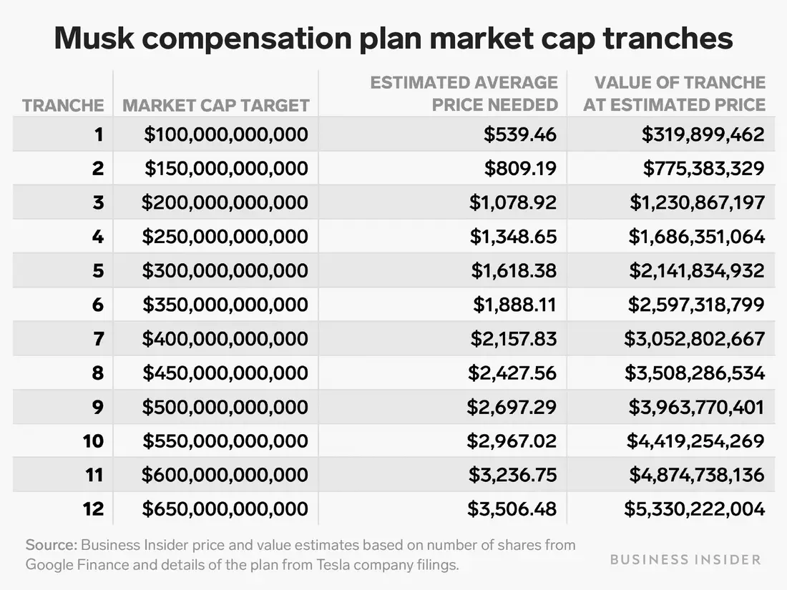
Compensation package for CEO

Slide 51
Compensation package for CEO
Each tranche of options, once vested, entitles Musk to buy up to 1,688,670 shares of Tesla stock at a price of $350.02 a share, or the closing price at the time of the agreement. So, if Tesla's stock is trading right at the $539.46 level needed to hit a $100 billion valuation, he'd essentially net a profit of $189.44 a share, making the overall first tranche worth just shy of $320 million.
At Tesla's price as of 10 AM Eastern Time Friday of about $809 a share, the total value of the first tranche would be about $780 million.
Source: Business Insider, 20 May 2020
Notes:
https://www.businessinsider.com/elon-musk-tesla-compensation-package-tranches-explainer

