Slide 1
Lesson 12: Financing a business
Notes:
Chapter 15, Peter Atrill

Slide 2
Learning objectives
Able to
Identify the main sources of finance available to a business and explain the advantages and disadvantages of each;
Outline the ways in which share capital may be issued;
Explain the role and nature of the Stock Exchange;
Discuss the ways in which smaller businesses may raise finance.

Slide 3
Introduction
Firms can raise funds either from internal or external sources.
Retained earning vs issue of new shares.
We can further distinguish between
Long-term (for at least 1 year)
Short-term (less than 1 year)
Notes:
retained profit is considered an internal source because
the directors of the business have power to retain profits without the agreement of the shareholders, whose profits they are. Finance from an issue of new shares, on the other hand, is an external source because it requires the compliance of potential shareholders.

Slide 4
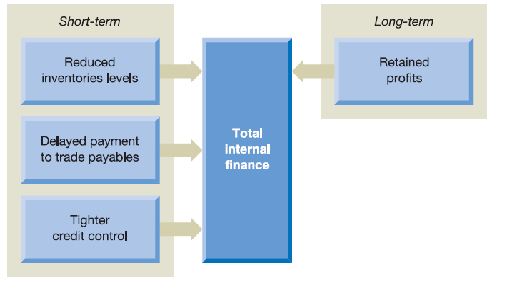
Internal sources of finance
Flexible and obtained quickly.

Slide 5
Walmart paid Wall Street investors $12 billion last year to keep them happy. Amazon paid $0.

Slide 6
Internal sources of finance (Long-term)
Retained earnings
A major source of finance for firms
Keeping the profit in the firms rather than distributing to the shareholders (dividends)
Do you think that retained earnings a free source of finance to the firms?
Notes:
Answer: It is tempting to think that retained profits are a cost-free source of funds for a business. However, this is not the case. If profits are reinvested rather than distributed to shareholders in cash, those shareholders cannot invest this cash in other forms of investment. They will therefore expect a rate of return from the profits reinvested that is equivalent to what they would have received had the funds been invested in another opportunity with the same level of risk.

Slide 7
Internal sources of finance (Long-term)
Retained earnings
No effect on the extent to the existing shareholders control the business.
Decision to pay dividends is made by the directors.
Does not have to wait to receive new funds from outside.

Slide 8
Internal sources of finance (Long-term)
Retained earnings
Disadvantages: timing and the level of future profits cannot be estimated.
Larger firms pay dividends regularly and keep the remaining for business expansion.

Slide 9
sources of finance (Long-term)
Issue new shares (external)
The issue costs may be substantial
Uncertainty over the success of the issue.
Impact on dilution of control.

Slide 10
Internal sources of finance (short-term)
Tighter credit control
Control over amounts owed by debtors
Funds tied up with trade receivables will refrain the firms to generate more profit.
Disadvantages: lost customer goodwill and lost sales
To stay competitive, firms need to take the average credit terms within the industry.

Slide 11
Internal sources of finance (short-term)
Case study 1: Sales= Price * Units
Answer:
The current cost of trade credit:
Cost under new policy
Allowances for receivables (bad debts) | £
Overdraft interest (£10,000,000 *10%*45/365) | £
Total | £
Overdraft interest (£10,000,000*0.95*10%*30/365) | £
Cost of control procedures | £
Net cost of lost sales (£10m/£20*5%)* contribution per unit (selling price – variable cost per unit)= 25000 units* £6 | £
Total | £

Slide 12
Internal sources of finance (short-term)
Case study 1: Sales= Price * Units
Answer:
The current cost of trade credit:
Cost under new policy
Allowances for receivables (bad debts) | £ | 100 000
Overdraft interest (£10,000,000 *10%*45/365) | £ | 123288
Total | £ | 223288
Overdraft interest (£10,000,000*0.95*10%*30/365) | £78082
Cost of control procedures | £50 000
Net cost of lost sales (£10m/£20*5%)* contribution per unit (selling price – variable cost per unit)= 25000 units* £6 | £150000
Total | £278082

Slide 13
Internal sources of finance (short-term)
Reducing inventories level
Funds are more available for those opportunities.
Firms must ensure sufficient inventories available to meet future sales demand.
Failure to do: lost customer goodwill and lost sales revenue

Slide 14
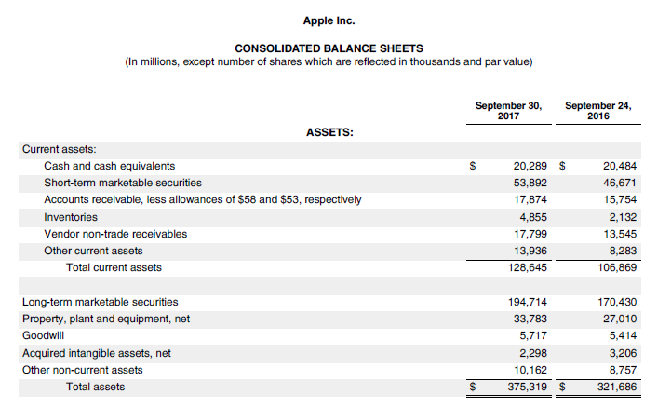

Slide 15
Internal sources of finance (short-term)
Delaying payment to trade payables
This is an interest-free loan.
Delays the payment is an extended funds retained within the firms.
There is significant cost if firms fail to pay within credit period. Reputation will be affected.

Slide 16
Class activity: Fill in the blanks
Sources of finance
Internal sources
Long-term
Short-term
External sources

Slide 17
Class activity: Fill in the blanks (Answers)
Sources of finance
Internal sources
Long-term
Short-term
External sources
Retained earnings
Delayed payment to trade creditors
Tighter credit control
Reduced inventories level

Slide 18
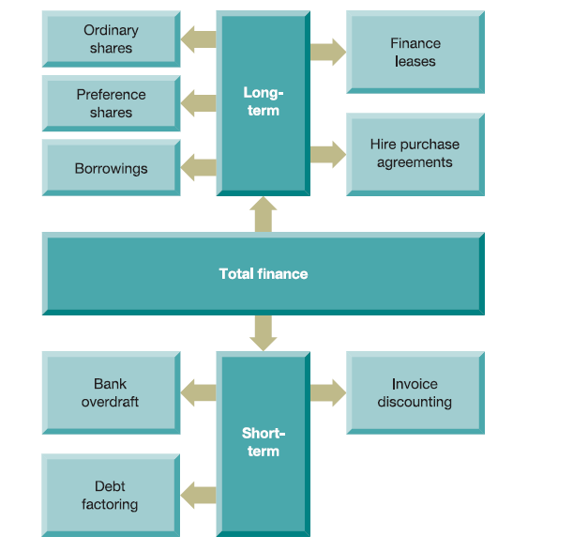
External sources of finance

Slide 19
External sources of finance (long-term)
Ordinary shares
Important external financing
It represent the firm’s risk capital- a comparatively high return is required.
No fixed dividends
Received dividend if profits available for distribution after lenders and preference shareholders.

Slide 20
External sources of finance (long-term)
Ordinary shares
Downside risk is limited.
Potential returns are unlimited.
Voting rights- control the business
Question:
What circumstances might a business find it useful to avoid paying a dividend?
Notes:
An expanding business may prefer to retain funds to help fuel future growth.
● A business in difficulties may need the funds to meet its operating costs and so may find making a dividend payment a real burden.

Slide 21
External sources of finance (long-term)
Ordinary shares
Firms do not obtain any tax relief on dividends paid to shareholders.
Paying £1 of dividend is more expensive than £1 of loan interest on borrowings.

Slide 22
External sources of finance (long-term)
Preference share
Lower risk than ordinary shares
Received a fixed dividend each year.
Question:
Would you expect the returns on preference shares to be higher or lower than those of ordinary shares?
Notes:
We expect returns on preference shareholders to be lower than those on ordinary shares.
This is because of the lower level of risk associated with this form of investment (preference
shareholders have priority over ordinary shareholders regarding dividends).

Slide 23
Example:
Warren Buffett's been a fan of the banking industry for a long time, and some of his best investments over the past 10 years have been in banks he bailed-out in 2008 during the Great Recession, including Goldman Sachs. In exchange for $5 billion, Buffett got preferred shares in Goldman Sachs yielding 10% and warrants that allowed him to buy millions of Goldman Sachs shares prior to October 2013.
Source: The Motley Fool
Notes:
https://www.fool.com/investing/2018/11/16/top-stocks-warren-buffett-just-bought.aspx

Slide 24
External sources of finance (long-term)
Preference share
Disadvantages: dividends paid are not tax deductible.
Both preference shares and ordinary shares are, in effect, redeemable. The firm is allowed to buy back the shares from shareholders at any time.

Slide 25
Example:
Buffett netted about a 35% return when Goldman Sachs repurchased the preferred stock from him in 2011.
Source: The Motley Fool

Slide 26
External sources of finance (long-term)
Loans
Both lender and borrower enter into contract
Interest rate
Dates of interest payment
Capital repayment
Security of loan
Notes:
In the event that the interest payments or capital repayments are not made on the due dates, the lender will usually have the right, under the terms of the contract, to seize the assets on which the loan is secured and sell them in order to repay the amount outstanding. Security for a loan may take the form of a fixed charge on particular assets of the business (land and buildings are often favoured by lenders) or a
floating charge on the whole of its assets. A floating charge will ‘float’ over the assets and will only fix on particular assets in the event that the business defaults on its loan obligations.

Slide 27
External sources of finance (long-term)
Term loans
Tailored to the needs of the firms.
Offered by banks and financial institutions
The amount of the loan, the time period, the repayment terms and the interest payable are all open to negotiation and agreement.
Advantages: cheaper to set up and flexible.
Notes:
For example, where all of the funds to be borrowed are not required immediately, a business may agree with the lender that funds are drawn only as and when required. This means that interest will be paid only on amounts drawn and the business will not have to pay interest on amounts borrowed that are temporarily surplus to requirements. Term loans tend to be cheap to set up (from the borrower business’s perspective) and can be quite flexible as to conditions.

Slide 28
External sources of finance (long-term)
Loan notes/ loan stock/ bonds
Divided into units
Investors are invited to purchase the number of units they required.
May be redeemable/ irredeemabe
Can buy from Stock Exchange(PLC)

Slide 29
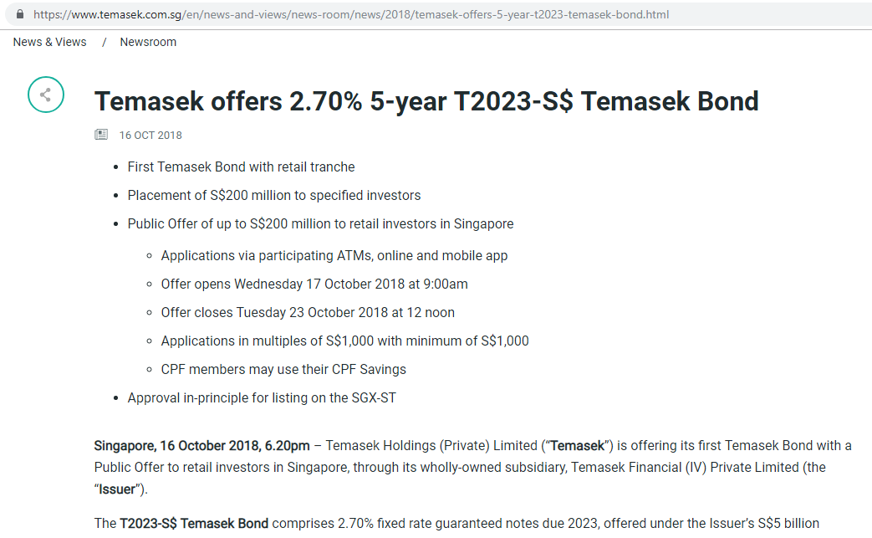

Slide 30
Example:
On September 15, 2008, Lehman Brothers filed for bankruptcy. With $639 billion in assets and $619 billion in debt, Lehman's bankruptcy filing was the largest in history, as its assets far surpassed those of previous bankrupt giants such as WorldCom and Enron. Lehman was the fourth-largest U.S. investment bank at the time of its collapse, with 25,000 employees worldwide.
(Source: Investopedia)
96.87% (debt)

Slide 31
External sources of finance (long-term)
Eurobonds
unsecured loan notes denominated in a currency other than the home currency of the business that issued them.
Raised on an international basis.
Interest paid annually.
Advantage: access to large number of international investors

Slide 32
External sources of finance (long-term)
Question: Would you expect the returns to loan capital to be higher or lower than those of preference shares?
Notes:
Investors are usually prepared to accept a lower rate of return. This is because they will normally view loans as being less risky than preference shares. Lenders have priority over any claims from preference shareholders, and will usually have security for their loans.

Slide 33
External sources of finance (long-term)
Convertible loan notes
Right for investors to convert their bonds to ordinary shares at a specified price (exercise price)
This is not an obligation.
Exercise price is usually higher than the market price of those ordinary shares at the time of issue of the convertible loan notes.

Slide 34
External sources of finance (long-term)
Convertible loan notes
To hedge against risk
Adv: to offer lower rate of return because investors expect to earn future benefits from conversion

Slide 35
External sources of finance (long-term)
Warrants
Holders have the right, but not the obligation to buy newly issued ordinary shares at the exercise price.
The warrant will usually state the number of shares that the holder may buy and the time limit within which the option to buy them can be exercised.
Do not confer voting rights or entitle the holders to make any claims on the assets of the business.

Slide 36
External sources of finance (long-term)
Warrants
Occasionally, these are given away for free to accompany an issue of loan notes.
Adv: to offer low interest rate and negotiate less restrictive loan conditions.
Enable investors to benefit from future increases in the share price.
If the share price < exercise price, the warrant will not be used.
Hedge against risk

Slide 37
External sources of finance (long-term)
Loan covenants
Certain obligations and restrictions on borrowers to protect themselves.
Financial statements
Other loans
Dividend payments
Liquidity
Any breach→ the lender may require immediate repayment of the loan
Notes:
Financial statements. The lender may require access to the financial statements of the borrowing business on a regular basis. ● Other loans. The lender may require the business to ask the lender’s permission before taking on further loans from other sources. ● Dividend payments. The lender may require dividend payments to be limited during the period of the loan. ● Liquidity. The lender may require the business to maintain a certain level of liquidity during the period of the loan. This would typically be a requirement that the borrower business’s current ratio is maintained at, or above, a specified level.

Slide 38
External sources of finance (long-term)
Question: (10 minutes)
Both preference shares and loan notes are forms of finance that require the business to provide a particular rate of return to investors. What are the factors that may be taken into account by a business when deciding between these two sources of finance?

Slide 39
Answer:
Factor 1: Preference shares tend to have a higher rate of return than loan notes.
Factor 2: Failure to pay a preference dividend is less important. No legal obligation to pay.
Factor 3: Preference dividends are not tax deductible.
Factor 4: Preference shares do not have restrictive covenant.
Notes:
Preference shares tend to have a higher rate of return than loan notes. From the investor’s point of view, preference shares are more risky. The amount invested cannot be secured, and the return is paid after the returns paid to lenders. ● A business has a legal obligation to pay interest and, typically, make capital repayments on loan stocks at the agreed dates. It will usually make every effort to meet its obligations because failure to do so can have serious consequences. (These consequences have been mentioned earlier.) Failure to pay a preference dividend, on the other hand, is less important. There is no legal obligation to pay if profits are not available for distribution. Failure to pay a preference dividend may prove an embarrassment for the business, however, because it may make it difficult to persuade investors to take up future preference share issues. ● It was mentioned above that the taxation system in the UK permits interest on loans to be allowable against profits for taxation, whereas preference dividends are not. As a result, the cost of servicing loan capital is, £ for £, usually much less for a business than the cost of servicing preference shares. ● The issue of loan notes may result in the management of a business having to accept some restrictions on its freedom of action. We saw earlier that loan agreements often contain covenants that can be onerous. However, preference shareholders can impose no such restrictions.

Slide 40
External sources of finance (long-term)
Finance lease
A form of lending
Legal ownership with the lessor.
Buy from the supplier
Lease to business
Lessor
lessee

Slide 41
External sources of finance (long-term)
Finance lease
Ease of borrowing
Cost
Flexibility
Cash flows
Notes:
Ease of borrowing. Leasing may be obtained more easily than other forms of long-term finance. Lenders normally require some form of security and a profitable track record before making advances to a business. However, a lessor may be prepared to lease assets to a new business without a track record, and to use the leased assets as security for the amounts owing. ● Cost. Leasing agreements may be offered at reasonable cost. As the asset leased is used as security, standard lease arrangements can be applied and detailed credit checking of lessees may be unnecessary. This can reduce administrative costs for the lessor and, thereby, help in providing competitive lease rentals. ● Flexibility. Leasing can help provide flexibility where there are rapid changes in technology. If an option to cancel can be incorporated into the lease, the business may be able to exercise this option and invest in new technology as it becomes available. This will help the business to avoid the risk of obsolescence. ● Cash flows. Leasing, rather than purchasing an asset outright, means that large cash outflows can be avoided. The leasing option allows cash outflows to be smoothed out over the asset’s life. In some cases, it is possible to arrange for low lease payments to be made in the early years of the asset’s life, when cash inflows may be low, and for these to increase over time as the asset generates positive cash flows.

Slide 42
External sources of finance (long-term)
Sale-and-leaseback
A business raising finance by selling an asset to a financial institution.
The sale is accompanied by an agreement to lease the asset back to the business to allow it to continue to use the asset.
The lease payment is allowable against profits for taxation purposes.

Slide 43
External sources of finance (long-term)
Hire purchase
A form of credit to acquire an asset.
Business will pay an initial deposit and then make an instalment payments at regular intervals until the balance has been paid.

Slide 44
External sources of finance (long-term)
Share issues
Rights issues
Offer for sale or public issues
Private placing

Slide 45
External sources of finance (long-term)
Rights issue
Reason:
Raise fund for expansion
To solve liquidity problem (cash shortage)
Law gives existing shareholders the right of refusal on these new shares.
The shares will offer to public after existing shareholders agree to waive their rights.

Slide 46
External sources of finance (long-term)
Rights issue
Firms prefer existing shareholders to buy the shares
The ownership remains in the same hands.
The costs of making the issue tend to be less if the shares are offered to existing shareholders.
Shares are always at price below the current market price.

Slide 47
External sources of finance (long-term)
Let’s workout with the calculation.

Slide 48
External sources of finance (long-term)
The role of the Stock Exchange
Singapore Exchange (SGX)
New York Stock Exchange (NYSE)
London Stock Exchange (LSE)

Slide 49
The role of the Stock Exchange
Acts for both primary and secondary markets.
Primary market- to enable firms to raise new capital.
Secondary market- shares and loan notes already in issue may be bought and sold.

Slide 50
The role of the Stock Exchange
To be a listed company,
Must meet fairly stringent requirements : size, profit history, information disclosure
Initial Public Offering (IPO)

Slide 51
The role of the Stock Exchange
Advantages:
Shares/ financial claims are easily transferable.
Prices are under scrutiny by financial analysts and investors.
Convenient way of buying and selling stocks.

Slide 52
The role of the Stock Exchange
Disadvantages:
Strict rules are imposed on listed firms.
Analysts tend to monitor closely the activities of the listed firms.
Often that listed firms are under pressure to perform well over the short term.
The cost of obtaining a listing are huge and deter some firms.

Slide 53
External sources of finance (short-term)
Bank overdraft
To remain a negative balance on its bank account
A very flexible form of borrowing as the size of the overdraft can be increased/ decreased.
Inexpensive and the interest rates are often very competitive (higher than term loan)
Con: repayable on demand

Slide 54
External sources of finance (short-term)
Debt factoring
Service offered by financial institution (factor)
The factor taking over the firm’s debt collection.

Slide 55
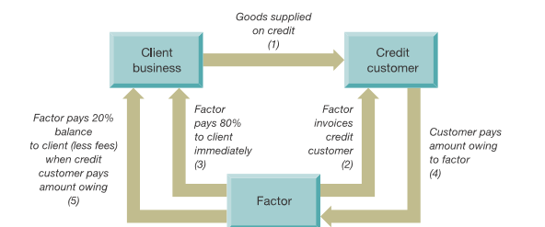
External sources of finance (short-term)

Slide 56
External sources of finance (short-term)
Invoice discounting
Factor providing the loan based on the proportion of the face value of a firm’s credit sales outstanding. For example, 75-80%
Firm must repay the advance within a relatively short period- 60 or 90 days.
The collecting of outstanding remains with the firm.

Slide 57
External sources of finance (short-term)
Invoice discounting:
It is a confidential form of financing
The service charge for invoice discounting is generally only 0.2-0.3%.
Firms unwilling to relinquish control of their customers’ records.

Slide 58
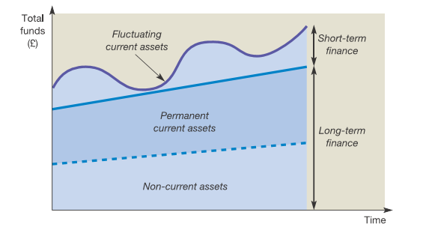
Long-term versus Short-term financing
Matching
Flexibility
Refunding risk
Interest rates

Slide 59
External sources of finance (Review)

