Slide 1
Lesson 9: Budgeting

Slide 2
Learning outcomes
Define a budget and show how budgets, strategic objectives and strategic plans are related
Explain the budgeting process and the interlinking of the various budgets within the business
Indicate the uses of budgeting and construct various budgets, including the cash budget, from relevant data
Show how the budget can be used to exercise control over the business

Slide 3
Budgeting
What is a budget?
What is it for?
How is it prepared?
Who prepares it?
How is it used?
Why does the board regard it as important enough to spend time on?
What is the budgeting process and interlinks?
How and why is performance monitored? Who does the monitoring? How the budget can be used to exercise control over the business?

Slide 4
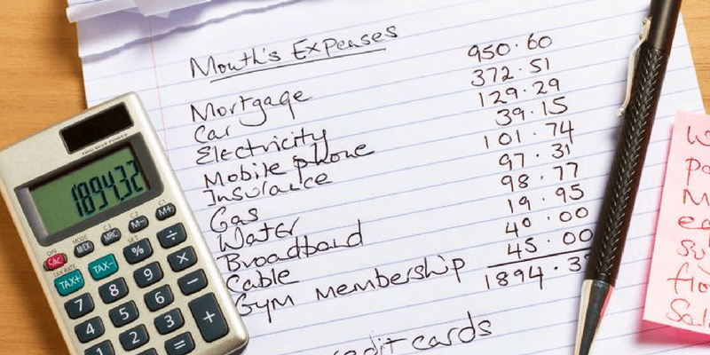
Budgeting
"A budget is just a method of worrying before you spend money, as well as afterward."

Slide 5
Budgeting
It is vital that businesses develop plans for the future. Whatever a business is trying to achieve, it is unlikely to happen unless its managers are clear what the future direction of the business is going to be.
The continuous cycle of planning and evaluation used by an entity in order to achieve the stated goals and objectives of the organization.
The process of allocating a finite amount of resources to the prioritized needs of the organization.
A tool we use to control spending decisions.

Slide 6
Mission, Strategic Objectives, Strategic Plans, Budgets
The mission sets the overall direction and, once set, is likely to last for quite a long time – perhaps throughout the life of the business;
The strategic objectives, which are also long term, will set out how the mission can be achieved;
The strategic plans identify how each objective will be pursued; and
The budgets set out, in detail, the short-term
Plans and targets necessary to fulfill the strategic objectives.

Slide 7
Budgeting -The planning and control process
Once the mission and objectives of the business have been determined, the various strategic options available must be considered and evaluated in order to derive a strategic plan.
The budget is a short-term financial plan for the business that is prepared within the framework of the strategic plan.
Control can be exercised through the comparison of budgeted and actual performance. Where a significant divergence emerges, some form of corrective action should be taken. If the budget figures prove to be based on incorrect assumptions about the future, it might be.

Slide 8
The planning and control process
Establish mission and objectives
Undertake a position analysis
Identify and assess strategic options
Select strategic options and formulate long-term (strategic) plans
Prepare budgets
Perform and collect information on actual performance
Identify variances between planned (budgeted) and actual performance
Respond to variances and exercise control
Revise plans (and budgets) if necessary
Figure 9.1
Notes:
Once the mission and objectives of the business have been determined, the various strategic options available must be considered and evaluated in order to derive a strategic plan. The budget is a short-term financial plan for the business that is prepared within the framework of the strategic plan. Control can be exercised through the comparison of budgeted and actual performance. Where a significant divergence emerges, some form of corrective action should be taken. If the budget figures prove to be based on incorrect assumptions about the future, it might be necessary to revise the budget.

Slide 9
Question
Do you think that planning (including budgeting) within a business should be the responsibility of managers or accountants?
Notes:
It should be the responsibility of managers. Although accountants play a role in the planning process, by supplying relevant information to managers and by contributing to decision making as part of the management team, they should not dominate the process.

Slide 10
Time Horizon of Plans and Budgets
Setting strategic plans is a major exercise normally performed every five years or so, and budgets are usually set for the forthcoming year, but no need for one year.
May vary according to the needs of the particular business, e.g. information technology.
2-3 years - more appropriate.
Strategic planning under frequent review.

Slide 11
The five main benefits of budgets to a business
Promote forward thinking and identification of short-term problems
Help co-ordinate the various sections of the business
Budgets
Motivate managers to better performance
Provide a system of authorisation
Provide a basis for a system of control
Figure 9.2
Notes:
The five benefits have been discussed in the chapter.

Slide 12
Question
Do you think a budget is a forecast?
Notes:
We have seen that a budget is a business plan for the short term, which is mainly expressed in financial terms. Note particularly that a budget is a plan, not a forecast. To talk of a plan suggests an intention or determination to achieve the targets; forecasts tend to be predictions of the future state of the environment.
Clearly, forecasts are very helpful to the planner/budget setter. If, for example, a reliable forecaster has predicted the number of new cars to be purchased in the UK during next year, it will be valuable for a manager in a car manufacturing business to take account of this information when setting next year’s sales budgets. However, a forecast and a budget are distinctly different.

Slide 13
Managers need take into account the limiting factors
Can you think of any ways in which a short- term shortage of production facilities of a manufacturer might be overcome?

Slide 14
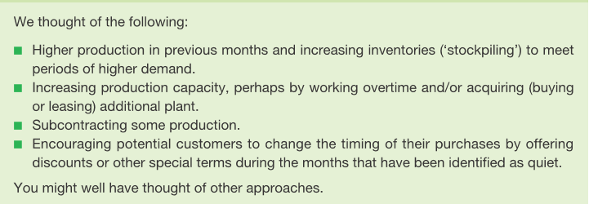
Answer

Slide 15
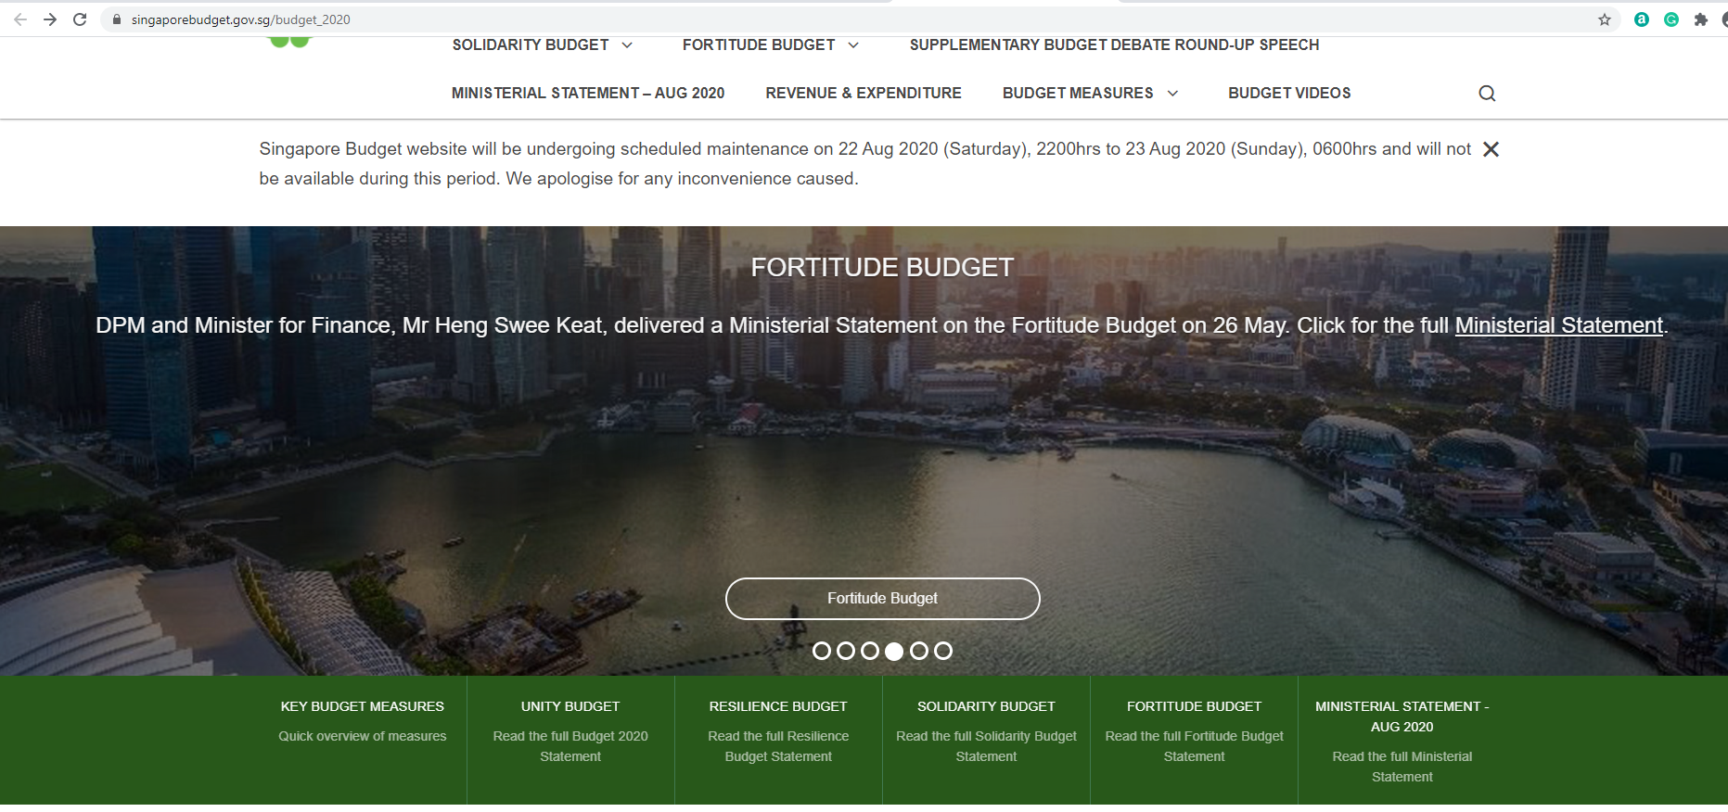
SG Budget

Slide 16
How budgets link to one another
Larger businesses will prepare more than one budget for a particular period.
Each budget prepared will relate to a specific aspect of the business.
The contents of all of the individual operating budgets will be summarised in master budgets consisting of a budgeted income statement and statement of financial position (balance sheet).

Slide 17
The interrelationship of operating budgets
Trade receivables budget
Cash budget
Trade payables budget
Capital expenditure budget
Direct labour budget
Raw materials purchases budget
Sales budget
Overheads budget
Finished inventories budget
Raw materials inventories budget
Production budget
Figure 9.3
Notes:
The starting point is usually the sales budget. The expected level of sales normally defines the overall level of activity for the business. The other operating budgets will be drawn up in accordance with this. Thus, the sales budget will largely define the finished inventories requirements and, from this, we can define the production requirements and so on. This shows the interrelationship of operating budgets for a manufacturing business.

Slide 18
The vertical relationship between a business’s sales budgets
Overall sales budget
Sales budget North region
Sales budget South region
Sales budget East region
Sales budget West region
Figure 9.4
Notes:
This business manages its sales through four geographical areas. The overall sales budget for the business as a whole is the sum of the four regional sales budgets.

Slide 19
The accuracy of revenue budgets
>50% over plan
2%
26–50% over plan
2%
11–25% over plan
12%
1–10% over plan
27%
Came in on plan
11%
1–10% under plan
28%
11–25% under plan
10%
>25% under plan
3%
Don’t know
5%
0
5
10
15
20
25
30
(%)
Figure 9.5 Source: Information from BPM Forum (2008), ‘Perfect how you project’.
Notes:
66 per cent of revenue budgets were accurate within a range of 10 per cent.

Slide 20
Cash Budget
It sets out all the cash receipts and payments that a business expects to make over a period of time.
Usually month-to-month basis.

Slide 21
Cash Budget
Running out of cash funds will require a huge problem to the company.
Any shortage of cash can be foreseen and action taken in good time to obtain a loan or a bank overdraft to cover the shortfall when it occurs.
When a cash budget had been prepared, the customer would be able to know in advance if the additional cash funds are needed.

Slide 22
In short,
Cash budget can reveal
How much is needed
When it will be needed

Slide 23
Case 1
Cash budget for Jenson’s for the six months ended Dec 31st 2013
 | July | August | September | October | November | December | Total
Cash in | (£) | (£) | (£) | (£) | (£) | (£) | (£)
Receipt
Total cash in
Cash out
Payment
Total cash out
Cash surplus for the month
Opening balance
Closing balance

Slide 24
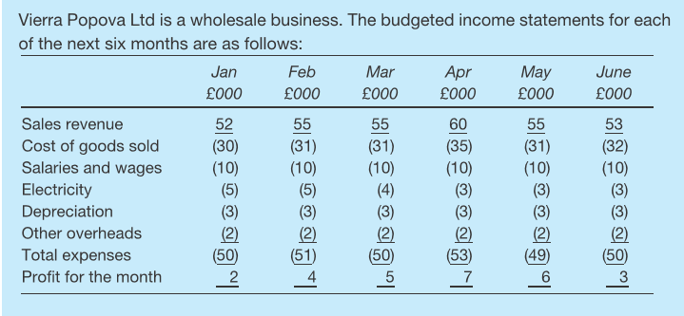
The cash budget- Example 9.1

Slide 25
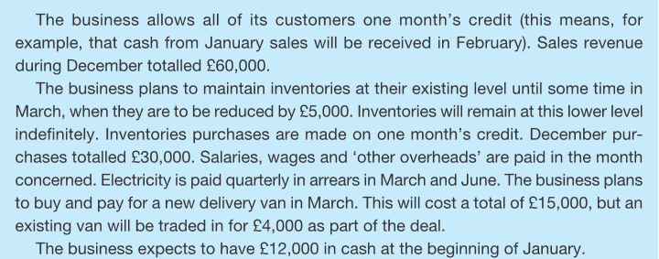
The cash budget- Example 9.1

Slide 26
An example of a budget – the cash budget
An example of a budget – the cash budget
Jan Feb Mar Apr May June
£000 £000 £000 £000 £000 £000
Receipts
Trade receivables 60 52 55 55 60 55
Payments
Trade payables (30) (30) (31) (26) (35) (31)
Salaries and wages (10) (10) (10) (10) (10) (10)
Electricity (14) (9)
Other overheads (2) (2) (2) (2) (2) (2)
Van purchase – – (11) – – –
Total payments (42) (42) (68) (38) (47) (52)
Cash surplus 18 10 (13) 17 13 3
Opening balance 12 30 40 27 44 57
Closing balance 30 40 27 44 57 60

Slide 27
Question
In the above example, what conclusions do you draw and what possible course of action do you recommend regarding the cash balance over the period concerned?
Notes:
Given the size of the business, there is a fairly large cash balance that seems to be increasing. Management might consider: ■ putting some of the cash into an income-yielding deposit; ■ increasing the investment in non-current (fixed) assets; ■ paying a dividend to the owners; and/or ■ repaying borrowings.

Slide 28
Preparing other budgets
Refer to the reading material, Example 9.2
Trade receivables budget
Trade payables budget
Inventories budget

Slide 29
An example of the inventories budget
 | Jan £000 | Feb £000 | Mar £000 | Apr £000 | May £000 | June £000
Opening balance | 30 | 30 | 30 | 25 | 25 | 25
Purchases | 30 | 31 | 26 | 35 | 31 | 32
Inventories used | (30) | (31) | (31) | (35) | (31) | (32)
Closing balance | 30 | 30 | 25 | 25 | 25 | 25

Slide 30
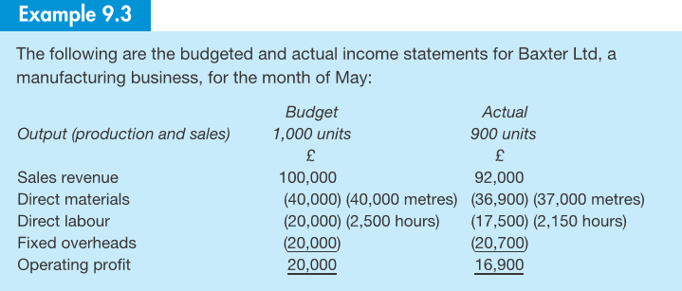
Measuring variances from budget

Slide 31
Flexible budgets
A more valid comparison can be made between the budget (using the flexed figures) and the actual results.
 | Original budget | Flexed budget | Actual
Output (production and sales) | 1,000 units | 900 units | 900 units
 | £ | £ | £
Sales revenue | 100,000 | 90,000 | 92,000
Direct materials | (40,000) | (36,000) (36,000m) | (36,900) (37,000m)
Direct labour | (20,000) | (18,000) (2,250 hr) | (17,500) (2,150 hr)
Fixed overheads | (20,000) | (20,000) | (20,700)
Operating profit | 20,000 | 16,000 | 16,900

Slide 32
Relationship between the budgeted and actual profit
Budgeted profit
plus
All favourable variances
minus
All adverse variances
equals
Actual profit
Figure 9.6
Notes:
The variances represent the differences between the budgeted and actual profit, and so can be used to reconcile the two profit figures.

Slide 33
Example:
Compare the sales revenue, raw materials and labour values between the flexed budget and the actual results and reconcile the original budget and the actual profit for Baxter Ltd. Remember that the sales volume variance is also part of the difference.

Slide 34
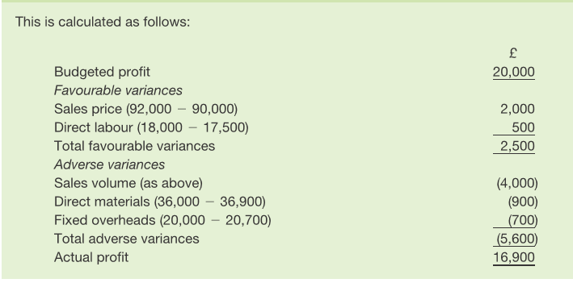
Answer:

Slide 35
Degree of importance attached to flexible budgeting
Moderately important 40%
Not important 27%
Important 33%
Figure 9.7
Source: Based on information in Abdel-Kader, M. and Luther, R. (2006), ‘Management accounting practices in the food and drinks industry’, CIMA Research.

Slide 36
Frequency of use of flexible budgets
1 = Never 5 = Very often
30
29
25
23
20
%
19
15
16
13
10
448
5
0
1
2
3
4
5
Scale
Figure 9.8 Source: Based on information in Abdel-Kader, M. and Luther, R. (2006), ‘Management accounting practices in the food and drinks industry’, CIMA Research.

Slide 37
Making Budgetary Control Effective
A serious attitude taken to the system.
Clear demarcation between areas of managerial responsibility.
Budget targets that are challenging yet achievable.
Established data collection, analysis and reporting routines.
Reports aimed at individual managers, rather than general-purpose documents.
Fairly short reporting periods.
Timely variance reports.
Action being taken to get operations back under control if they are shown to be out of control.

Slide 38
Seminar 9

