Slide 1
Lesson 8: Full costing

Slide 2
Learning outcomes
Deduce the full (absorption) cost of a cost unit in a single-product and a multi-product environment, using the traditional approach;
Discuss the problems of deducing full (absorption) cost in practice;
Discuss the usefulness of full (absorption) cost information to managers;
Explain the role and nature of activity-based costing

Slide 3
Full costing
Full cost is total amount of resources, measured in monetary terms, sacrificed to achieve a given objective.
If the objective were to supply a customer with a product or service, the cost of all aspects of making the product or rendering the service would be included as part of the full cost.
To derive the full cost figure, we must accumulate the
elements of cost incurred and then assign them to the particular product or service.
A cost unit is one unit of whatever is having its cost determined. This is usually one unit of output of a particular product or service.

Slide 4
Uses of full cost by managers
Assessing relative efficiency
Pricing and output decisions
Uses of full cost
Exercising control
Assessing performance

Slide 5
Single Product Businesses - Process Costing
Where all the units of output are identical, the full cost can be calculated as:
Cost per unit
→Total cost of output / Number of units produced
For example:
Ingredients £390
Fuel £85
Rent of accommodation £350
Depreciation of equipment £75
Labour £880, Units produced 7,300 litres
Adding all of the elements of cost incurred and then dividing by the number of litres produced:
£(390 + 85 + 350 + 75 + 880)/7,300 = £0.24 per litre

Slide 6
Multi-Product Businesses- Job costing
Where units of output are not identical, it is necessary to divide the cost into two categories: direct cost and indirect cost (overheads).
Direct cost = cost that can be identified with specific cost units – the effect of the cost can be measured in respect of each particular output
Indirect cost (or overheads) = cost that cannot be directly measured in respect of a particular Job
Full (absorption) cost = direct cost + indirect cost

Slide 7
Multi-Product Businesses- Job costing
Direct/indirect is not linked to variable/fixed.
Indirect cost is difficult to relate to individual cost units- arbitrary bases are used and there is no single correct method.
Traditionally, indirect cost is seen as the cost of providing a “service” to cost units.
Direct labour hour basis of applying indirect cost to cost units is the most popular in practice.

Slide 8
Percentage of full cost contributed by direct and indirect cost
80
75
69
60
Percentage of full cost
49
51
40
31
20
25
0
All 176 businesses
Manufacturing businesses (91)
Service and retail businesses (85)
Direct cost
Indirect cost
Figure 8.2
Source: Al-Omiri, M. and Drury, C. (2007) ‘A survey of factors influencing the choice of product costing systems in UK organisations’, Management Accounting Research, December, pp. 399–424.

Slide 9
The relationship between direct cost and indirect cost
Direct cost of the job
Appropriate share of indirect cost (overheads)
Full cost of the job
To deduce the full cost of a particular cost unit, we first identify the direct cost of the cost unit, which, from the definition of direct cost, is fairly straightforward.
To ‘charge’ each cost unit with an ‘appropriate’ share of indirect cost (overheads)

Slide 10
Example
Justify direct cost or indirect cost of a particular job?
the wages of the electrician who did the job;
depreciation of the tools used by the electrician;
the cost of cable and other materials used on the job;
rent of the building where Sparky Ltd stores its inventories of cable and other materials.
It is important to note that whether a cost is direct or indirect depends on the item being costed – the cost objective.
To refer to indirect cost without identifying the cost objective is potentially misleading

Slide 11
The relationship between fixed cost, variable cost and total cost
Fixed cost
Variable cost
Total (or full) cost
The total cost of a job is the sum of the cost that remains the same irrespective of the level of activity (fixed cost) and that which varies according to the level of activity (variable cost).

Slide 12
Question
Are variable cost and direct cost the same, and fixed cost and indirect cost (overheads) the same?

Slide 13
Answer:
Fixed cost and variable cost are defined in terms of how costs behave in the face of changes in the volume of activity.
Direct cost and indirect cost, on the other hand, are defined in terms of the extent to which they can be identified with, and measured in respect of, particular cost units (jobs).

Slide 14
The relationship between direct, indirect, variable and fixed costs of a particular job
Fixed cost
Variable cost
Indirect cost (overheads)
Total (or full) cost of a particular job
Direct cost
Figure 8.5
Notes:
A particular job’s full (or total) cost will be made up of some variable and some fixed cost elements. It will also be made up of some direct and some indirect (overhead) elements.

Slide 15
The Indirect Cost Issue
While indirect cost must form part of the full cost of each cost unit, it cannot, by definition, be identified directly with particular cost units.
This raises a major practical issue: how can indirect cost be assigned to individual cost units?
Sharing overheads equally?

Slide 16
Overheads as service renderers
Indirect cost (overheads) can be viewed as rendering a service to cost units.
For example, a legal case undertaken by a firm of solicitors for a particular client.
It seems reasonable to charge each case with a share of the cost of running the office (rent, lighting, heating, cleaning, building maintenance and so on).
How might the cost of running the office, which is a cost incurred for all the work undertaken by the firm, be divided between individual legal cases that differ in size and complexity?

Slide 17
Example
Johnson Ltd, a business that provides a personal computer maintenance and repair service, has overheads of £10,000 each month. Each month 1,000 direct labour hours are worked and charged to cost units (jobs carried out by the business). A particular repair undertaken by the business used direct materials costing £15. Direct labour worked on the repair was 3 hours and the wage rate is £16 an hour.
Johnson Ltd charges overheads to jobs on a direct labour hour basis.
What is the full (absorption) cost of the repair?

Slide 18
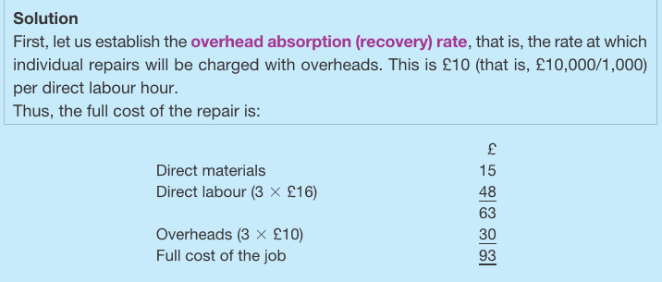
Answer:

Slide 19
Question:
Marine Suppliers Ltd undertakes a range of work, including making sails for small sailing boats on a made-to-measure basis. The business expects the following to arise during the next month:
Direct labour cost £60,000
Direct labour time 6,000 hours
Indirect labour cost £9,000
Depreciation of machinery £3,000
Rent £5,000
Heating, lighting and power £2,000
Machine time 2,000 hours
Indirect materials £500
Other miscellaneous indirect production cost elements (overheads) £200
Direct materials cost £3,000
The business has received an enquiry about a sail. It is estimated that the particular sail will take 12 direct labour hours to make and will require 20 square metres of sailcloth, which costs £2 per square metre. The business normally uses a direct labour hour basis of charging indirect cost (overheads) to individual jobs.
What is the full (absorption) cost of making the sail?

Slide 20
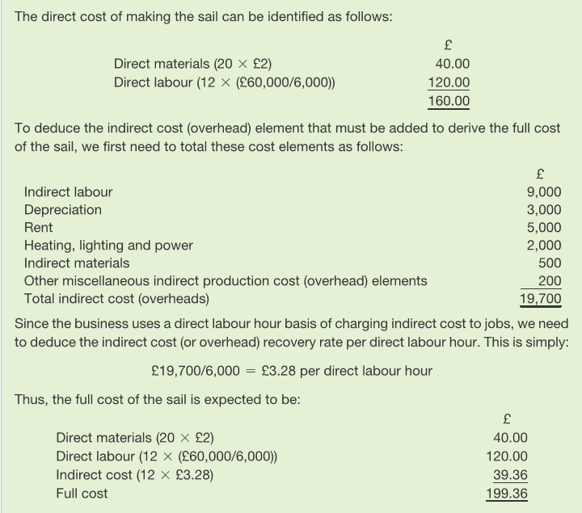
Answer

Slide 21
Deriving the full cost of the sail made by Marine Suppliers Ltd.
Overheads
Apply the overhead absorption rate (based on the specifics of the job, for example direct labour hours)
Ascertain the total overheads for Marine supplies Ltd for the period
Derive a suitable overhead absorption rate for the business as a whole
A particular sail (job)
Direct cost
Direct labour Cost of direct labour for the sail
Direct materials Cost of the direct materials to make the sail
Figure 8.6
Notes:
The full cost is made up of the sail’s (job’s) share of the total overheads, plus the direct cost element that is measured specifically in relation to the particular sail.

Slide 22
Question
Suppose that Marine Suppliers Ltd (previous question) used a machine hour basis of charging overheads to jobs. What would be the cost of the particular job if it was expected to take 5 machine hours (as well as 12 direct labour hours)?

Slide 23
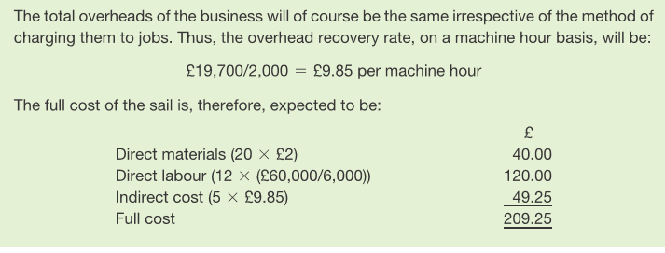
Answer

Slide 24
Selecting a basis for charging overheads
A business, that provides a service, expects to incur overheads totalling £20,000 next month. The total direct labour time worked is expected to be 1,600 hours and machines are expected to operate for a total of 1,000 hours. During the next month, the business expects to do just two large jobs. Information concerning each job is as follows:
How much of the total overheads will be charged to each job if overheads are to be charged on:
(a) a direct labour hour basis
(b) a machine hour basis?
What do you notice about the two sets of figures that you calculate?
 | Job 1 | Job 2
Direct labour hours | 800 | 800
Machine hours | 700 | 300

Slide 25
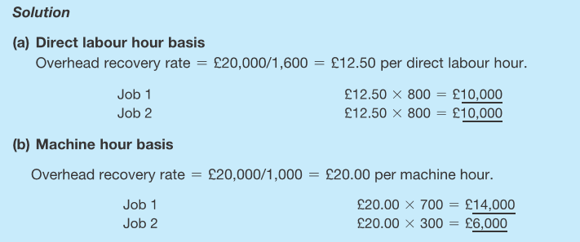
Answer

Slide 26
The effect of different bases of charging overheads to jobs
Total overheads for next month (£20,000)
Direct labour hour basis
Job 1 (£10,000)
Job 2 (£10,000)
Machine hour basis
Job 1 (£14,000)
Job 2 (£6,000)
Figure 8.7
Notes:
The share of the total overheads for the month charged to jobs can differ significantly depending on the basis used.

Slide 27
Overhead recovery rates in practice
A survey of 129 UK manufacturing businesses showed that the direct labour hour basis was overwhelmingly the most popular, by 72% of the respondents to the survey.
15% of respondents used a ‘production-time based overhead rate’, like a machine-hour rate.
Though this survey applied businesses, in the absence provides some impression practice.
Source: Based on information taken from, Brierley, J., Cowton, C. and Drury, C. (2007) Product costing practices in different manufacturing industries: A British
survey, International Journal of Management, December pp. 667–675.

Slide 28
Segmenting the overheads
A business may be divided into separate areas (cost centres) for costing purposes, charging overheads differently from one area to the next, according to the nature of the work done in each.

Slide 29
Segmenting the overheads
Taking the same business as in previous question, on closer analysis we find that of the overheads totalling £20,000 next month, £8,000 relate to machines (depreciation, maintenance, rent of the space occupied by the machines and so on) and the remaining £12,000 to more general overheads. The other information about the business is exactly as it was before.
How much of the total overheads will be charged to each job if the machine-related overheads are to be charged on a machine hour basis and the remaining overheads are charged on a direct labour hour basis?

Slide 30
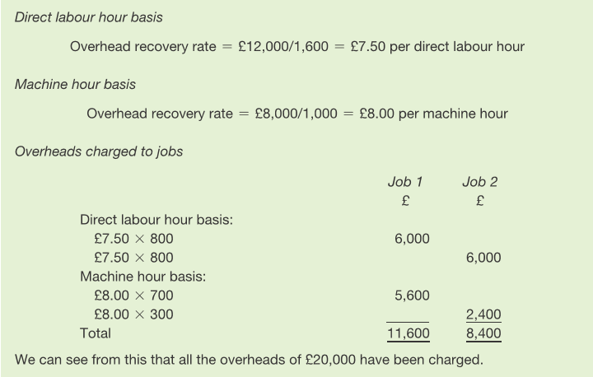
Answer

Slide 31
Dealing with overheads on a cost centre basis
Dealing with overheads on a cost centre basis
Reasons for dividing a business into departments include:
Indirect cost (overheads) can be segmented – usually on a cost centre basis – and each product cost centre has its own overhead recovery rate.
Cost centres are areas, activities or functions for which cost is separately determined.
Size and complexity
Expertise
Accountability

Slide 32
A cost unit (Job A) passing through Autosparkle Ltd’s process
Preparation department
Paintshop department
Finishing department
Customers
Job A
* Direct materials * Direct labour * A share of the Preparation department’s overheads
* Any further direct cost * A share of the Paintshop’s overheads
* Any further direct cost * A share of the Finishing Department’s overheads
+
+
=
Full cost of the job
Cost accumulated
Figure 8.8
Notes:
As the particular paint job passes through the three departments, where work is carried out on it, the job ‘gathers’ cost of various types.

Slide 33
Analysis of the number of cost centres within a business
40
36
30
29
UK businesses (%)
20
21
14
10
0
1–5 cost centres
6–10 cost centres
11–20 cost centres
more than 20 cost centres
Figure 8.9 Source: Based on information taken from Drury, C. and Tayles, M. ‘Profitability analysis in UK organisations’, (2006), British Accounting Review, December, pp. 405–425.
Notes:
The survey of larger businesses shows, as might be expected, that they tend to have several cost centres.

Slide 34
Batch costing
Many types of goods and some services are produced in a batch of identical, or nearly identical, units of output.
Each batch produced, however, is distinctly different from other batches.
A theatre, for example, may put on a production whose nature and cost is very different from that of other productions.
The cost per ticket is calculated using batch costing and involves:
using a job costing approach (taking account of direct and indirect costs and so on) to find the cost of mounting the production; and then
dividing the cost of mounting the production by the expected number of tickets to be sold to find the cost per ticket.

Slide 35
Deriving the cost of one cost unit where production is in batches
The full cost of the batch, delivered on a ‘job-costing’ basis
divided by
The number of cost units (products) in the batch
equals
The full cost of one cost unit (product)
Figure 8.10
Notes:
The cost for the batch is derived using a job-costing basis and this is divided by the number in the batch to determine the cost for each cost unit.

Slide 36
Costing and pricing: the traditional way
Direct-labour-intensive and direct-labour-paced production
A low level of indirect cost relative to direct cost
A relatively uncompetitive market

Slide 37
Costing and pricing: the new environment
Capital-intensive and machine-paced production
A high level of overheads relative to direct cost
A highly competitive international market

Slide 38
Activity-based Costing
Activity-based costing is an approach to dealing with overheads (in full costing) that treats all costs as being caused or ‘driven’ by activities.
Advocates argue that it is more relevant to the modern commercial environment than is the traditional approach.
Identification of the cost drivers can lead to more relevant indirect cost treatment in full costing.
Identification of the cost drivers can also lead to better control of overheads.
Critics argue that ABC is time-consuming and expensive to apply – not justified by the possible improvement in the quality of information.
Full cost information is seen by some as not very useful because it can be backward looking: it includes information irrelevant to decision making, but excludes some relevant information.

Slide 39
Activity-based costing – what drives the costs
Identify:
Each support activity involved in making products/services
The costs attributed to each support activity
The factors that cause a change in these costs (cost drivers)

Slide 40
Activity-based costing – attributing overheads
Establish an overhead cost pool for each activity
Allocate the total cost of each support activity to the relevant cost pool
Charge the total cost in each pool to output using the relevant cost drivers

Slide 41
Refer to reading material

Slide 42
Traditional versus activity-based costing
Traditional approach
Overheads are first assigned to product cost centres
Overheads are then allocated to cost units using an overhead recovery rate
Product cost centre 1
Cost centre overhead recovery rate 1
Products
Total overheads
Product cost centre 2
Cost centre overhead recovery rate 2
A
B
C
D
Product cost centre 3
Cost centre overhead recovery rate 3
ABC approach
Overheads are first assigned to cost pools
Overheads are then assigned to cost units using cost driver rates
Activity cost pool 1
Activity cost driver rate 1
Products
Total overheads
Activity cost pool 2
Activity cost driver rate 2
A
B
C
D
Activity cost pool 3
Activity cost driver rate 3
Activity cost pool 4
Activity cost driver rate 4
Figure 8.11 Source: Adapted from Activity Based Costing: A Review with Case Studies, J. Innes and F. Mitchell, CIMA Publishing, 1990.
Notes:
With the traditional approach, overheads are first assigned to product cost centres and then absorbed by cost units based on an overhead recovery rate (using direct labour hours worked on the cost units or some other approach) for each cost centre. With activity-based costing, overheads are assigned to cost pools and then cost units are charged with these elements to the extent that they drive the costs in the various pools.

Slide 43
Benefits of ABC
Provides more accurate cost for each unit of product or service
Provides managers with a better understanding of the business

Slide 44
Seminar 8
Q&A; Group Coursework Supervision

