Slide 1
Union and Employer Perspectives
EMPL601 Workshop

Slide 2
Agenda
Brainstorm: What are the different perspectives of Employers/Business and Unions on Employment Relations?
How much influence do they have?
Union and Business policy on employment relations: what do they want?
Which political party would Unions or Business Associations vote for?

Slide 3
What are the different perspectives of Employers/Business and Unions on Employment Relations?
Whose interests are they most worried about?
What do they think is most important for employment relations? For the economy?
Who has more power: Unions or Business? Why?

Slide 4
Influencing Policy and Law: Council of Trade Unions
Notes:
https://www.youtube.com/watch?v=NF2oSD3EjJU
Note that some thought this was an ‘attack’ ad. But, it does speak to the actual policy of National.
Does the Council of Trade Unions support a National led government?

Slide 5
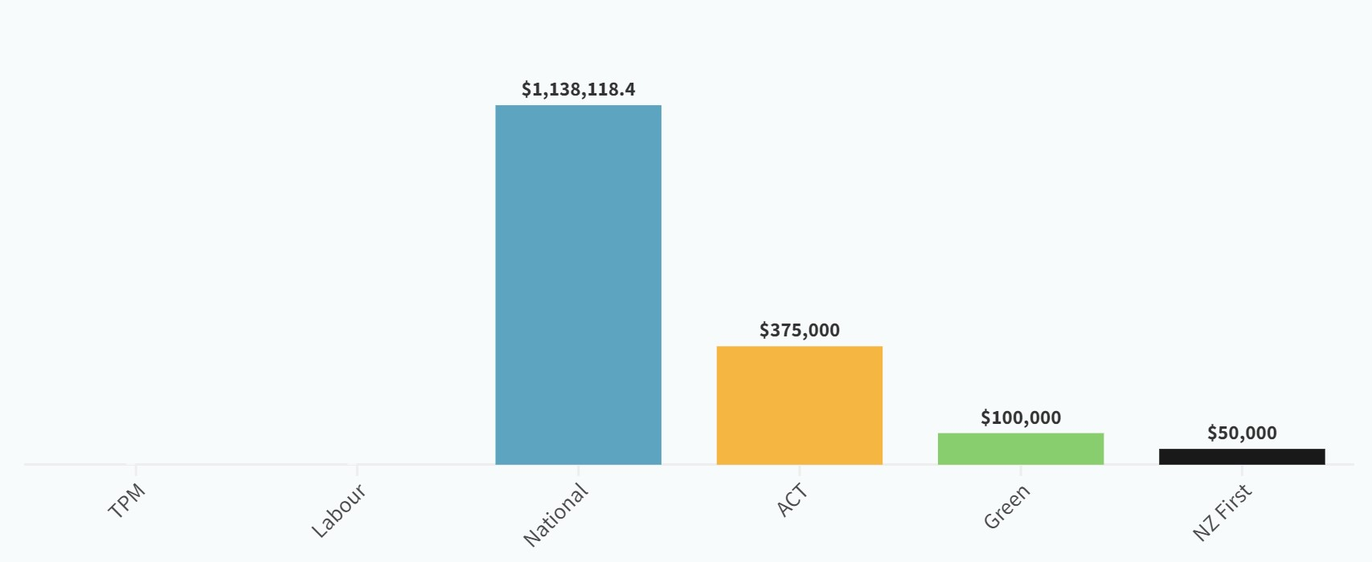
Influencing Policy and Law: Lobbying
WATCH: https://www.newshub.co.nz/home/politics/2023/03/behind-new-zealand-s-uncontrolled-million-dollar-lobbying-industry.html
Additionally, National and Act parties receive large donations from Business, with none to Labour in 2 years:
Notes:
Lobbying has significant impact on political parties, and corporate lobbyists are common. Even universities employ ‘government relations’ PR people.
National receives 7.5 times more $ than Labour in donations. This comes from wealthy individuals and businesses.
https://www.stuff.co.nz/national/politics/300970685/no-significant-donations-to-the-labour-party-from-businesses-in-over-two-years
Political donation summaries can be found here (note that Green MPs all donate a % of their MP salary to the party):
https://elections.nz/democracy-in-nz/political-parties-in-new-zealand/party-donations-and-loans-by-year/

Slide 6
Union and employer policy
You will have one short article to read. This will be from a Union or Employer Association.
Answer these questions and be ready to report back to the class:
What is the policy/law/issue that the stakeholder is talking about?
What are the key points that they make about this policy/law/issue?
What would change would they like to see and why?
What impact would the changes they suggest have on employees/unions and employers/business?

Slide 7
Matching the stakeholder to political party
What do each of the political parties currently in government say about the issue in your ‘stakeholder’ article? Come up with 1 – 3 key points.
Which of these political parties would your stakeholder be likely to vote for? Why?

Slide 8
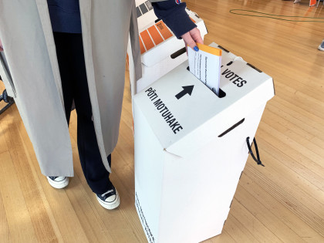
For more information on voting in 2023
https://vote.nz/2023-general-election/about/2023-general-election/

Slide 9
Useful links at AUT
AUTSA (student union) https://www.autsa.org.nz/
Student Hub https://www.aut.ac.nz/student-life/support-services/student-hub
Student Medical Centre https://www.aut.ac.nz/student-life/student-health-and-wellbeing/student-medical-centre
Counselling and mental health support https://www.aut.ac.nz/student-life/student-health-and-wellbeing/counselling-and-mental-health-support
Student support services https://www.aut.ac.nz/student-life/support-services
Notes:
Student support services links to:
Disability support
High performance athlete support
International student support
Māori student support
Multifaith and spiritual support
Pacific Student support
Peer support
Postgraduate research student support
Rainbow student support: LGBTQIA+ services and resources
Refugee and resettled communities student support
Scholarship student support

