Slide 1
Doughnut Economics & Employment Relations
EMPL601 Workshop

Slide 2
Overview
Recap of what Doughnut Economics is (see Week 9 lecture).
How does it apply to Employment Relations?
What kind of policy/laws would be relevant?
Doughnut Economics in real life: How do political parties stack up?

Slide 3
Doughnut Economics
The economy is situated within the social world and the natural environment – the ‘market’ is not a separate entity.
It argues that if we are to continue to exist, and thrive, there is a ‘safe and just space for humanity’.
Working towards the collective needs of society and the environment.
A big shift from current versions of capitalism, such as neoliberal ideology which dominates in Aotearoa currently.
What do you think of Doughnut Economics? Agree or disagree with its key points?
Notes:
Instead of a focus on individual gains and profit, it argues that the economy is situated within the social world and the natural environment.
It argues that if we are to continue to exist, and thrive, there is a ‘safe and just space for humanity’.
This is with a just social foundation and within the planetary boundaries.
Rather than competition in the market, it argues that our economy and society needs to work towards goals that meet the needs of society and the environment (not just business needs for profit). i.e. rather than economic policy, society and the environment serving the needs of Business, our businesses should work in a way that allows us to leave in the ‘safe and just space’.

Slide 4
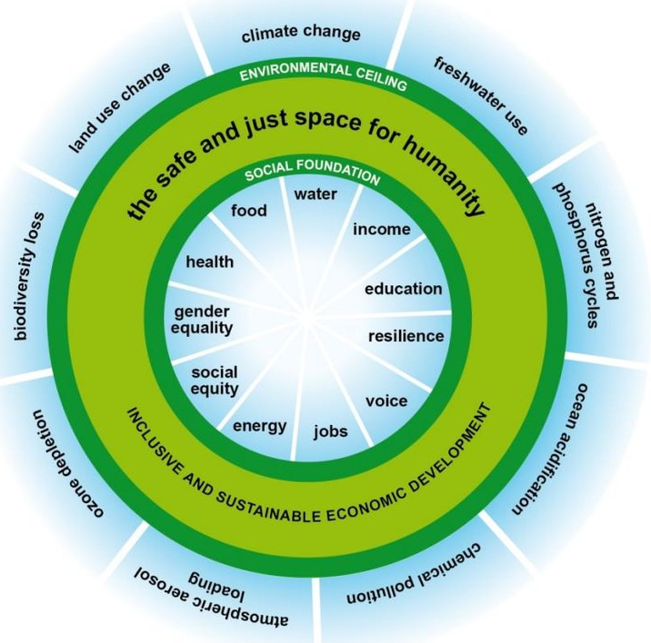
The ‘Doughnut’ and Employment Relations
What are some parts of the Social Foundations you don’t understand?
What might the role of ‘jobs’ be?
What other parts of the Social Foundation interact with employment relations? Why?
What does the environmental ceiling have to do with it?
Notes:
Most obvious is the role that jobs play in the social foundations.
How can our labour market and economy contribute to jobs that also provide social equity, gender equity, health, education, voice, income?
When we think of employment relations, then we need to broaden our view of the stakeholders in employment relations.
We also need to expect that the stakeholders, policy and law take a broader approach to ER that encompasses the social foundations and environmental ceiling, and that works towards inclusive and sustainable societies.
Notes: the Living Wage addresses a lot of the Social Foundation aspects of Doughnut Economics
Voice: think of taking part in local (Mayors and councillors) and national elections; being on School Boards, taking part in NFP community groups that work towards community needs (could even lobby and organise), knowing that your experience and knowledge (and that of your community) is listened to and understood. At work – how much say do you have in 1) day to day activities (think of how you do tasks, allocation of tasks within a team, organising rosters etc), 2) input into strategic direction of your workplace 3) ability to make decisions on how to allocate resources, who to hire etc 4) does your employer keep you up to date with what’s happening with their company? 5) do they welcome unions and work with unions?

Slide 5
Political Party Policy - Te Pāti Māori
Half the class will work on ‘The environmental ceiling’, half on ‘social foundations’.
https://www.maoriparty.org.nz/
In your group, find Te Pāti Māori policy.
Identify the policy that might relate to your topic. Read the policy.
Which parts of the doughnut does it relate to? Why?
What parts of the social or environmental parts is it missing?
Report back to the class.
Notes:
Political party policy not only influences social thoughts and norms (and should also respond to society) but can become the laws that govern how we work, what is acceptable for employers/employees/unions etc.
It also governs what Business and individuals are required to do for the environment.
Te Pāti Māori is a registered political party that is currently in government. As a ‘minor’ party with fewer resources it is not getting much attention in mainstream media and society. It also has policy that clearly relates to the environment and to society. So, it is a useful political party to focus on in this exercise.

Slide 6
Employment-Society-the Environment
What connections are there between the environmental focused policy, social policy and work/employment related policy?
Do you think that as a whole Te Pāti Māori’s policy would mean that we’d be living within the ‘safe and just’ zone of Doughnut Economics?

Slide 7
Useful links at AUT
AUTSA (student union) https://www.autsa.org.nz/
Student Hub https://www.aut.ac.nz/student-life/support-services/student-hub
Student Medical Centre https://www.aut.ac.nz/student-life/student-health-and-wellbeing/student-medical-centre
Counselling and mental health support https://www.aut.ac.nz/student-life/student-health-and-wellbeing/counselling-and-mental-health-support
Student support services https://www.aut.ac.nz/student-life/support-services
Notes:
Student support services links to:
Disability support
High performance athlete support
International student support
Māori student support
Multifaith and spiritual support
Pacific Student support
Peer support
Postgraduate research student support
Rainbow student support: LGBTQIA+ services and resources
Refugee and resettled communities student support
Scholarship student support

