Slide 1
Emerging Perspectives in Health Information Systems/Technologies (Health IS/IT)
CHAPTER 1

Slide 2
Scenario: Charting the Future
Collaboration between Philips Health-Suite digital platform and Samsung ARTIK Smart IoT platform
Continuous collection, storage, and analysis of health information
Access for patients
Real-time information for care providers
Integrated datasets for third-party developers

Slide 3
Introduction
Increasing pressure to adapt health IS/IT and applications of health informatics (HI)
Major sources of concern
New perspectives in health management information systems (HMIS)
Evolved from rapid breakthroughs in health IS/IT and communication networks

Slide 4
Scoping the HMIS Field
Typical health IS/IT system
Integrated health information processing engine
Links interrelated human-computer components for collection of patient data
Used for health-related physical and cognitive activities
ACA’s meaningful use mandate
Core domains for the IS/IT field
Health IS/IT resources management

Slide 5
Routine Business vs. Health Data, Information, and Knowledge (1 of 2)
Health data
Emphasis toward need for complex professional expertise and higher-level processing
Largely textual in nature
Business data
Common to be automated for routine processing

Slide 6
Routine Business vs. Health Data, Information, and Knowledge (2 of 2)
Health data elements
Specific facts and parameters
Characteristics of good data
Characteristics of clinical datasets
Unique
Non-transactional
Large range of data type
Important considerations for health data

Slide 7
The Need for and Challenge of a Digital Health Ecosystem (1 of 2)
Critical to invest in digital healthcare infrastructure
Lead to seamless exchange of health information and improved coordination of care delivery services
Structure of a digital health ecosystem
Promotes the right channeling of information
Key health data exchanges at each level

Slide 8
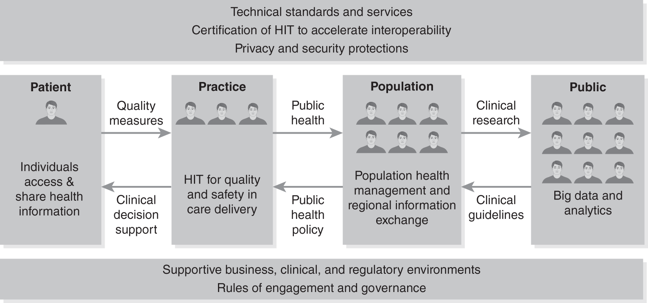
Health IS/IT Ecosystem
Data from Connecting Health and Care for the Nation: A 10-Year Vision to Achieve an Interoperable Health IT Infrastructure. https://www.healthit.gov/sites/default/files/ONC10yearInteroperabilityConceptPaper.pdf

Slide 9
The Need for and Challenge of a Digital Health Ecosystem (2 of 2)
Potential uses of big data generated by EHRs
Key challenge
Need to achieve seamless connectivity and interoperability among different components within and among ecosystems
Complex and multifaced components
Changes in the healthcare industry

Slide 10
EHR
Premier and most used health IS/IT systems for clinical care services
Identifies and maintains a patient record
Manage the patient’s problem, medication, and allergy lists based on interactions with a clinician along a longitudinal basis
Manage clinical documents and notes

Slide 11
Defining the Basic Functions of a Typical Health IS/IT System
Enhancing EHR functions
Capacity to provide clinical decision support
Three common forms of health data management
Database management
Data analytics
Knowledgebase management
Quality displays and representations of health data
Importance of interoperability

Slide 12
Major Health IS/IT Components (1 of 4)
Data/information/knowledge
Hardware/software/firmware/server
Process/task/system
Systems network integration/media interoperability
User/administration/management facing

Slide 13
Major Health IS/IT Components (2 of 4)
Content and data component
Central core of all health IS/IT
Managing complex care decisions
Need for greater integration
Infrastructure component
Choice deployment of technologies
E.g. Philips-Samsung initiative

Slide 14
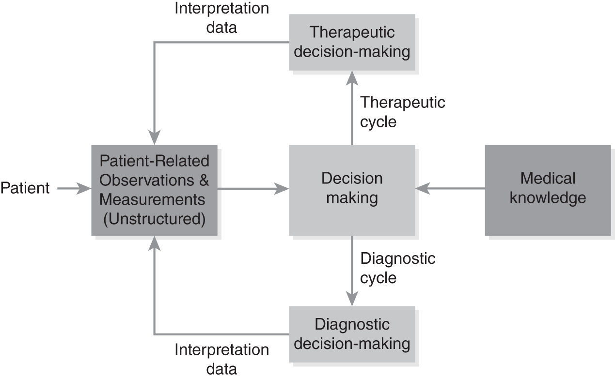
A Data/Information/Knowledge Decision System

Slide 15
Major Health IS/IT Components (3 of 4)
Data analytics component
Primary data processing and internalized data analytic engine
Focus shifts to providing a probable diagnosis and rational insights
Integration/interoperability component
Systems perspective

Slide 16
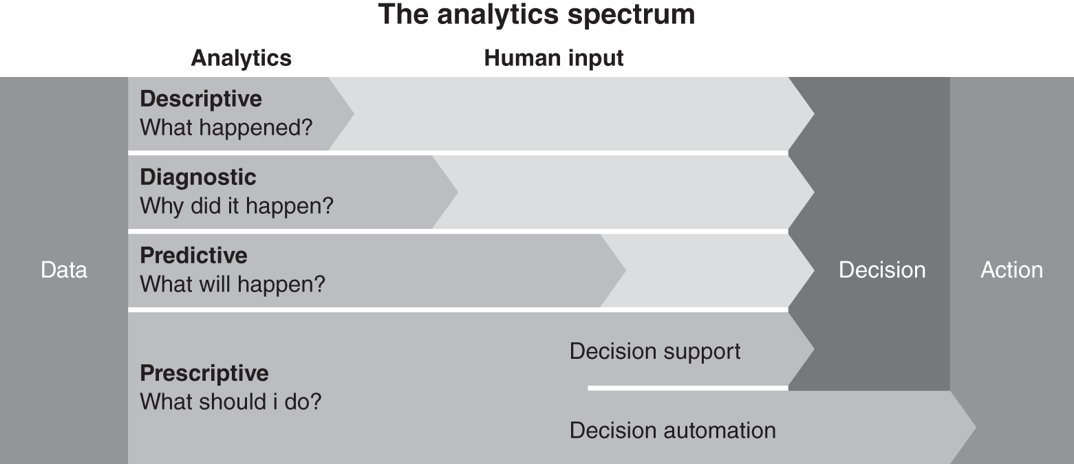
Stages of HMIS Analytics
Reproduced from Gartner Data & Analytics Summit Presentation, The Foundation of Data Science and Machine Learning: Achieving Advanced Insights and AI for Analytics, Peter Krensky, 29-30 May 2019.

Slide 17
Major Health IS/IT Components (4 of 4)
Platform/interface component
Combines and coordinates all of the other IS/IT components
Holistic conceptualization
Gateway for health IS/IT features, functions, and capabilities
IST as integral part of organizational system
Five major themes for HMIS field

Slide 18
HMIS Cultures (1 of 2)
Determines the appropriate product mix, roll out, and use of HMIS solutions
Information-functional culture
Traditional view of information as power
Limited flow of information
Information-sharing culture
Promotes trust among employees of different units within the same system

Slide 19
HMIS Cultures (2 of 2)
Information-inquiring culture
Makes core values, beliefs, and purpose of organization clear
Easily accessible critical information
Information-discovery culture
Insights shared freely
Encourages collaboration
Culture taken into consideration for implementation of health IS/IT solutions

Slide 20
Conclusion
Emergent perspectives of HMIS
Impact on futures of health services delivery
Major components of a typical health IS/IT system
Key health IS/IT themes
Strategic, tactical, and operational functioning of a health learning system

