Slide 1
RNA PROCESSING Part-1

Slide 2
mRNA processing
DNA
pre-mRNA
Mature mRNA
Protein
Transcription
hnRNP
pre-mRNA + specific proteins
Capping
m7G
Splicing
m7G
Cleavage + Polyadenylation
m7G
(A)n
Nucleus
Cytoplasm
Translation
m7G

Slide 3
mRNA Capping

Slide 4
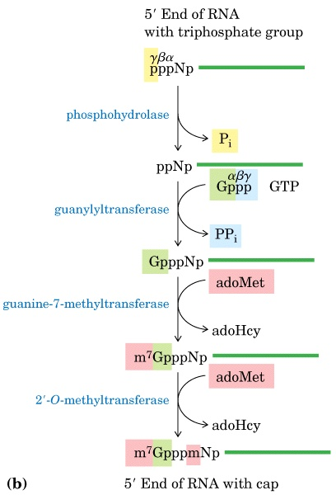
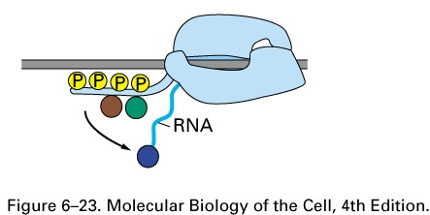
RNA processing step 1: Capping
1. As soon as RNA pol has made 25nt
nascent RNA a 5’-cap is put on the
mRNA.
2. Capping enzymes bind to the RNA polymerase tail (C terminal domain) and are ready to cap the RNA as it is made.
Notes:
adoMet = S-adenosyl methionine
adoHcy = S-adenosyl homocysteine

Slide 5
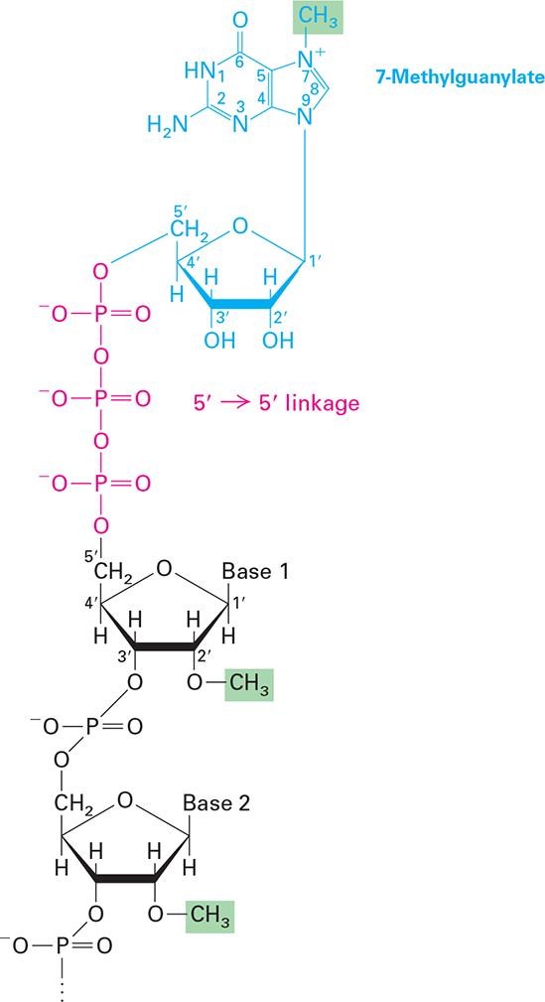
Reverse polarity 5’-5’ bond

Slide 6
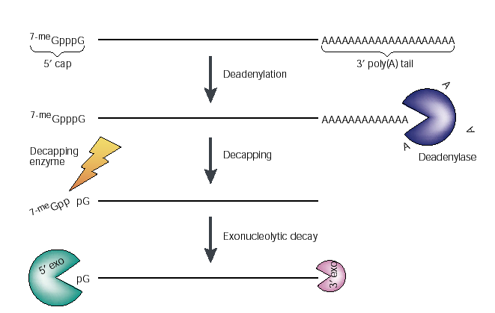
Functions of the mRNA cap
1. Facilitates splicing, 3’-endcleavage, polyadenylation, and perhaps nuclear export. Cap needed for the first intron to be spliced.
2. The cap (together with the poly(A) tail) is vital for mRNA stability.
Decapping is a key step in mRNA turnover.
Notes:
Reference:
Wilutz, C. J. et al. Nat. Rev. Mol. Cell Biol. 2, 237-246 (2001)

Slide 7
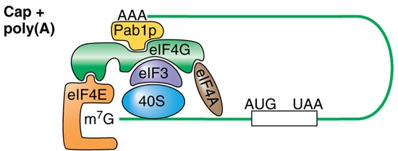
Functions of the mRNA cap
3. The cap enhances translation by binding to eIF4E and with the aid of the poly(A) tail provides scaffolding to directly bind and load the 40S ribosome for translation.

Slide 8
mRNA Polyadenylation

Slide 9
RNA processing step 3: Polyadenylation
AAAAAAAA…AAA
Also called 3’ end formation.
Most cytoplasmic mRNAs have a polyA tail at the 3’ end, usually 80-250 b long.
a notable exception is histone mRNA.

Slide 10
RNA processing step 3: Polyadenylation
Cap
AUG
STOP
AAUAA
G/U
5’UTR
3’UTR
AAUAA and the GU-rich regions are the main signals, both well conserved across evolution in eukaryotes.
Cleavage occurs between these two sites, about 30 nt after the AAUAA.
PolyA is added to the free 3’ end.
AAUAA sequence can be many kilobases downstream of the stop codon.

Slide 11
Polyadenylation site

Slide 12
Polyadenylation
Cap
AUG
STOP
AAUAA
G/U
CPSF: Cleavage and Polyadenylation Specificity Factor
5 sub-units: Fip1, CPSF30, CPSF73, CPSF100, CPSF160
CPSF160 recognises the AAUAA
Fip1 and CPSF30 regulate binding at the AAUAA
CPSF73 carries out the actual cleavage
CStF: Cleavage Stimulation Factor
3 subunits: CstF50, CstF64, CstF77
CstF64 recognises the G/U-rich region
CstF50 interacts with the pol II CTD
Notes:
Here you need to note that CPSF and CstF are protein complexes. Detailed knowledge of the subunits is not critical at this stage

Slide 13
Polyadenylation
symplekin
Cap
AUG
STOP
AAUAA
G/U
Symplekin brings the CPSF and CStF complexes together.
Cleavage factors CF1 and CFII are recruited.
CFs and CPSF recruit poly adenylate polymerase PAP
Cleavage occurs between the AUAAA and G/U-rich region where CFs bind.

Slide 14
Polyadenylation
Cap
AUG
STOP
AAUAA
Cap
AUG
STOP
AAUAA
PAP adds a short poly A tail
This is bound by PABP2 which accelerates PAP action leading to the addition of up to 250 As.
AAAAAAAAA
Notes:
PAB2 is localised in the nucleus, and will be replaced by the cytoplasmic PABP1

Slide 15
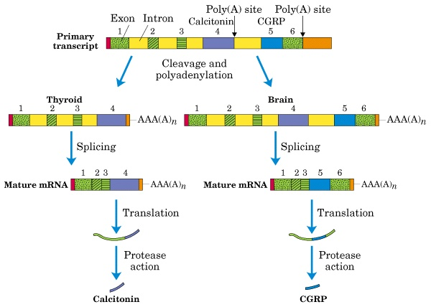
Example: Calcitonin and CGRP Come from the Same Gene
The tissue it’s expressed in determines which mature mRNA is produced
Notes:
The pre-mRNA has 2 polyA sites, one used in thyroid and one in brain.
Calcitonin is a calcium regulating hormone only produced in Thyroid.
Calcitonin gene-related protein (CGRP) is a neurotransmitter only produced in neurons.

Slide 16
Poly(A) mutations causing disease
Loss-of-function
•Alpha-thalassemias (Higgs et al, 1983; Harteveld et al, 1994)
•Beta-thalassemias (Orkin et al, 1985; Jankovic et al, 1990; Rund et al, 1992; van Solinge et al, 1996)
•IPEX syndrome (Bennett et al, 2001)
•Metachromatic leukodystrophies (Gieselmann et al, 1989)
•Fabry disease (Yasuda et al, 2003)
•Acetyltransferase 1 polymorphism in colorectal cancer (Bell et al, 1995)
•Insulin-like growth factor 1 deficiency (Bonapace et al, 2003)
•X-linked severe combined immunodeficiency (Hsu et al, 2000)
Gain-of-function Thrombophilia (Gehring et al, 2001; Ceelie et al, 2004; Danckwardt et al, 2004, 2006b, 2007; Kuwahara et al, 2004)
Notes:
Loss or gain of function mutations affecting polyadenylation can cause disease.
Reference:
3′ end mRNA processing: molecular mechanisms and implications for health and disease. Sven Danckwardt, Matthias W Hentze and Andreas E Kulozik. EMBO J. 2008 February 6; 27(3): 482–498.

Slide 17
Functions of the Poly(A) Tail
Promotes mRNA stability
Deadenylation (shortening of the polyA tail) can trigger rapid degradation of the mRNA
Enhances translation
- promotes recruitment by ribosomes: bound by a polyA-binding protein in the cytoplasm called PABP1
- synergistic stimulation of translation with Cap.

