Slide 1
GENE EXPRESSION: Regulation Part-1

Slide 2
Transcription Factors:
DNA Binding Domains
(GRPs)

Slide 3
DNA Binding Domains
1. Basic helix-loop-helix proteins
2. Zinc-finger proteins
3. Leucine-zipper proteins
4. Homeodomain proteins
……and many more

Slide 4
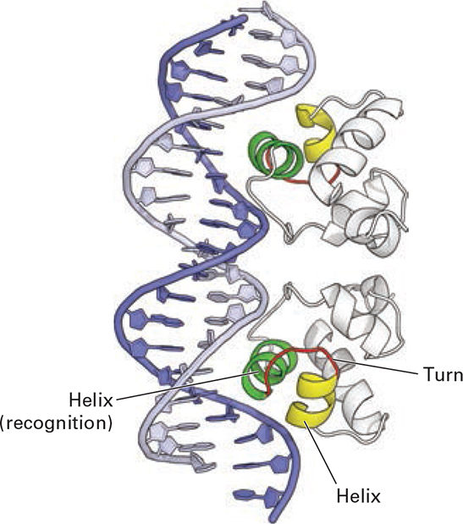
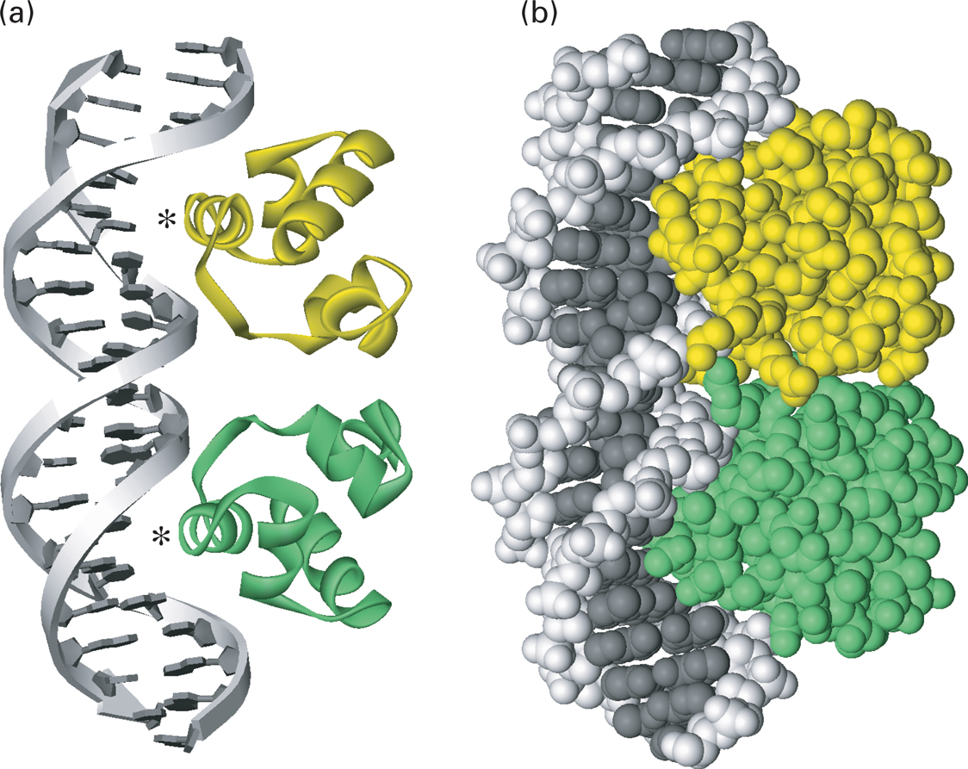
Interaction of bacteriophage 434 repressor with DNA.
Helix-loop-helix
Notes:
FIGURE 9-29 Interaction of bacteriophage 434 repressor with DNA. Ribbon diagram of 434 repressor bound to its specific operator DNA. The recognition helices are shown in green. The α helices N-terminal to the recognition helix and the turn in the polypeptide backbone between the helices in the helix-turn-helix structural motif are shown in yellow and red, respectively. The protein interacts intimately with one side of the DNA molecule over a length of 1.5 turns. (b) A space-filling model of the repressor-operator complex showing how the protein interacts intimately with one side of the DNA molecule over a length of 1.5 turns. [Data from A. K. Aggarwal et al., 1988, Science 242:899, PDB ID 2ori.]

Slide 5
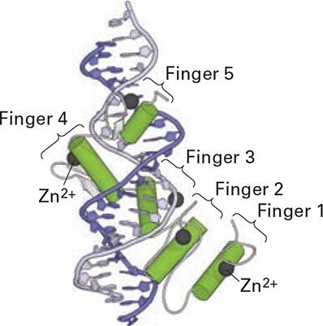
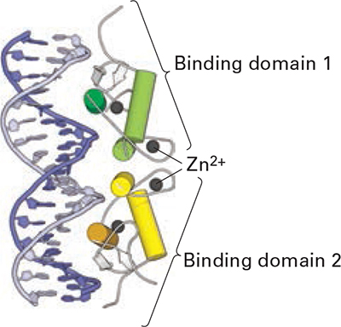
Eukaryotic DNA-binding domains that use an α helix to interact with the major groove of specific DNA sequences.
C₂H₂ zinc-finger protein (GAL1)
C₄ zinc-finger protein (Glucocorticoid receptor)
Notes:
FIGURE 9-30 Eukaryotic DNA-binding domains that use an α helix to interact with the major groove of specific DNA sequences. (a) The GL1 DNA-binding domain is monomeric and contains five C2H2 zinc fingers. The α helices are shown as cylinders, the Zn2+ ions as spheres. Finger 1 does not interact with DNA, whereas the other four fingers do. (b) The glucocorticoid receptor is a homodimeric C4 zinc-finger protein, one monomer in green, one in yellow. The α helices are shown as cylinders, the β strands as white arrows, the Zn2+ ions as spheres. Two α helices (darker shade), one in each monomer, interact with the DNA. Like all C4 zinc-finger homodimers, this transcription factor has twofold rotational symmetry. [Part (a), see N. P. Pavletich and C. O. Pabo, 1993, Science 261:1701, PDB ID 2gli. Part (b), see B. F. Luisi et al., 1991, Nature 352:497 PDB ID 1glu.]

Slide 6
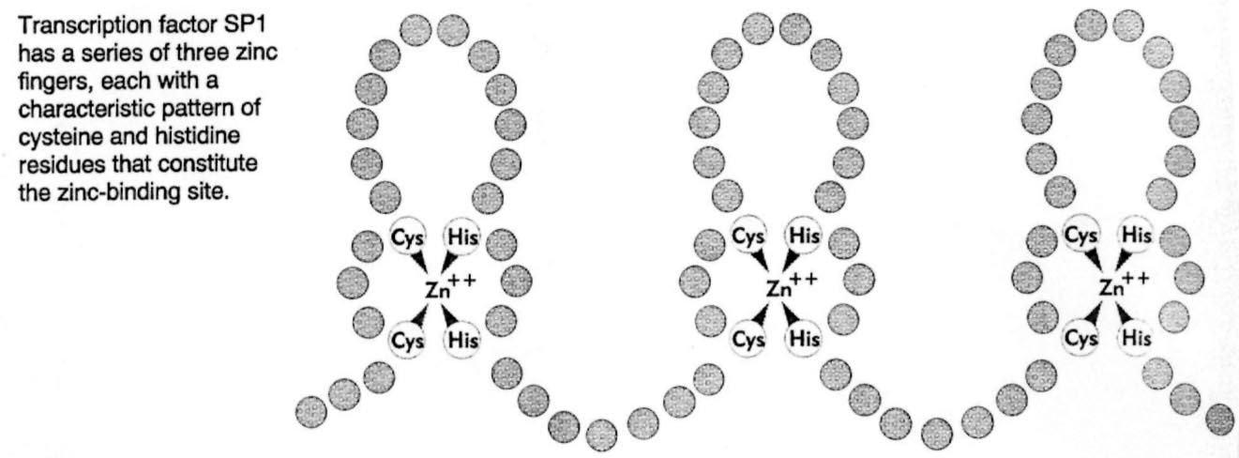
C₂H₂ Zinc Finger
Notes:
Zinc Finger
2) Zinc finger. Usually C2H2, Cys & His coordinate Zn in finger like projections which project into DNA.

Slide 7
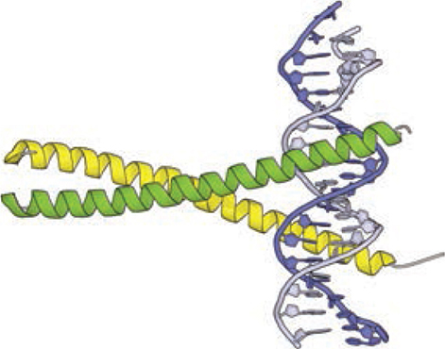
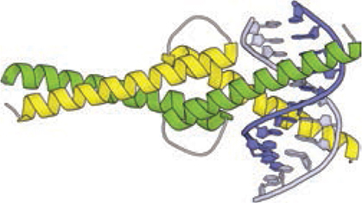
Eukaryotic DNA-binding domains that use an α helix to interact with the major groove of specific DNA sequences.
Leucine zipper
(c)
(d)
Notes:
FIGURE 9-30 Eukaryotic DNA-binding domains that use an α helix to interact with the major groove of specific DNA sequences. (c) In leucine-zipper proteins, basic residues in the extended α-helical regions of the monomers interact with the DNA backbone at adjacent sites in the major groove. The coiled-coil dimerization domain is stabilized by hydrophobic interactions between the monomers. (d) In bHLH proteins, the DNA-binding helices at the right (N-termini of the monomers) are separated by nonhelical loops from a leucine zipper–like region containing a coiled-coil dimerization domain. [Part (c), data from T. E. Ellenberger et al., 1992, Cell 71:1223, PDB ID 1ysa. Part (d), data from P. Brownlie et al., 1997, Structure 5:509, PDB ID 1hlo.]

Slide 8
Control of TFs - I

Slide 9
Control of TFs - II

Slide 10
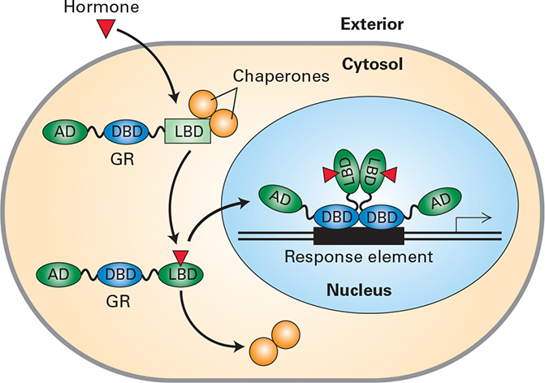
Mammalian TFs: Intracellular Receptor
Notes:
EXPERIMENTAL FIGURE 9-45 Fusion proteins demonstrate that the hormone-binding domain of the glucocorticoid receptor mediates trans-location to the nucleus in the presence of hormone. Model of hormone-dependent gene activation by a homodimeric nuclear receptor. In the absence of hormone, the receptor is kept in the cytoplasm by interaction between its ligand-binding domain (LBD) and chaperone proteins. When hormone is present, it diffuses through the plasma membrane and binds to the ligand-binding domain, causing a conformational change that releases the receptor from the chaperone proteins. The receptor with bound ligand is then translocated into the nucleus, where its DNA-binding domain (DBD) binds to response elements, allowing the ligand-binding domain and an additional activation domain (AD) at the N-terminus to stimulate transcription of target genes. [Parts (a)–(c) from Picard, D. and Yamamoto, K. R., “Two signals mediate hormone-dependent nuclear localization of the glucocorticoid receptor,” EMBO J., 1987, 6(11):3333–3340; courtesy of the authors.]

Slide 11
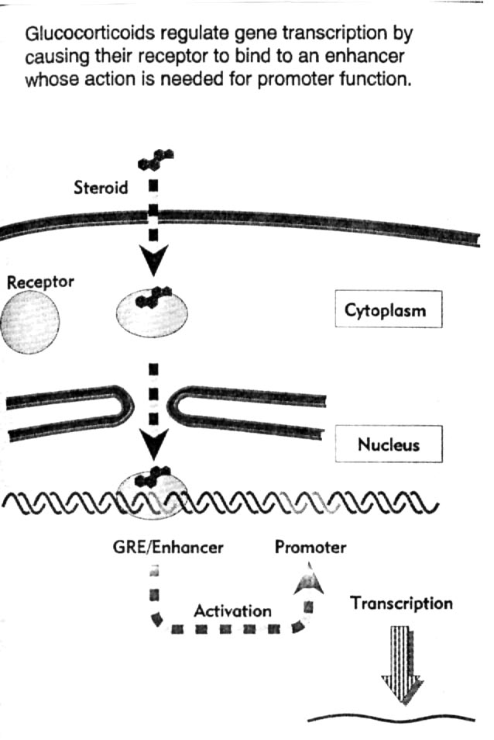
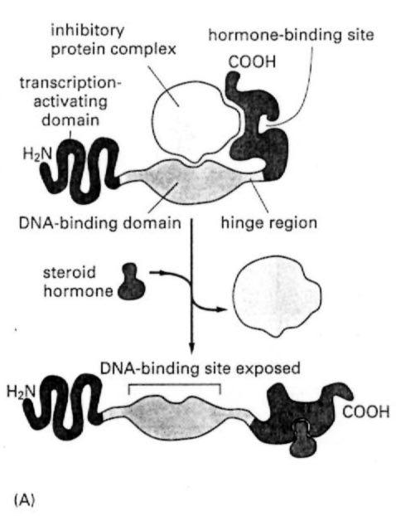
Glucocorticoid hormone Receptor
Notes:
Mammalian GRPs. Similar result as above but can be more complicated. eg Steroid hormone receptor family. (glucocorticoids)
Hormone enters cell & binds receptor in the cytoplasm. This complex then enters the nucleus and binds GRE. (Glucocorticoid Receptor Element) at the enhancer.
This family of GRPs have activation domain, DNA binding plus a steroid hormone binding site. There is also an inhibitory complex which binds receptor when not activated.
Binding of hormone causes conformational change and inhibitor complex (hsp90) released exposing DNA binding domain. Can now bind DNA and activate.

